Slide 1

Institutional Repository for Milligan College

Slide 2
Introduction

Slide 3
Objective
"The Milligan College Archivist in consultation with the Director of Library Services will explore the feasibility and options for establishing an institutional repository (IR) for Milligan College."
2012-13 Library IEP

Slide 4
Definition
An institutional repository (IR) is a centralized networked digital platform for uploading, organizing, preserving, and accessing electronically scanned (print to digital), converted (analog to digital), and born digital products and assets. An IR is an archive for the digital age, which can enhance the visibility of an educational institution by showcasing student and faculty work, the history of the institution, and the richness of the college experience.

Slide 5
Mission
"MCStor serves as Milligan College's digital repository intended to capture, distribute, and preserve scholarly work created by faculty, staff, and students at Milligan College, as well as materials of historical value to the College. MCStor provides access to digitized materials of the Milligan College Archives and Special Collections. By offering a central location for depositing these materials, MCStor makes them available to a wider audience and helps assure long-term preservation."
2014-15 Library IEP

Slide 6
What can go in the repository?
Student research papers, portfolios, theses
Faculty publications
Datasets
Photos
Digital/digitized art galleries
Speaker and performance audio & video recordings, transcripts
Promotional and marketing materials
College newspapers and yearbooks

Slide 7
What can go in the repository?
Alumni newsletters and magazines
Scanned and digitized historical documents
Special collections exhibits
Catalogs and other academic policy documents
Committee minutes
Accreditation documentation
Controlled access business records
Etc.

Slide 8
Process (it takes some time)
2012-13 – Exploration: review literature and webinars; query experience of other institutions; explore hardware, software, and staffing requirements; identify and engage Milligan College stakeholders. DSpace selected for IR platform.
2013-14 – Best Practices & Support: IT to host DSpace on campus servers; adapt Kalamazoo College's Digital Archive Policies; tentative name MCStor. Archivist (Lindsay) and Web Development Specialist (David) will staff MCStor.

Slide 9
Process (it takes some time)
2014-15 – Implementation: Install DSpace with initial 250GB storage; David to handle configuration and troubleshooting; Lindsay to handle policies, metadata, content submission, organization and access, copyright and licensing. Repository named MCStor with permanent web address; developed Mission Statement; loaded initial community/collection.
2015-16 – Promotion and Growth: Formally launched MCStor August 2015; workshops presented during Open Access Week. New collections created and content uploaded—ongoing.

Slide 10
Technical Overview

Slide 11

DSpace Platform
Open Source
Java web application
Originally developed by MIT & HP
First release in 2002
Source: D-Lib Magazine January 2003
Notes:
Philosophical attraction to Open Source

Slide 12
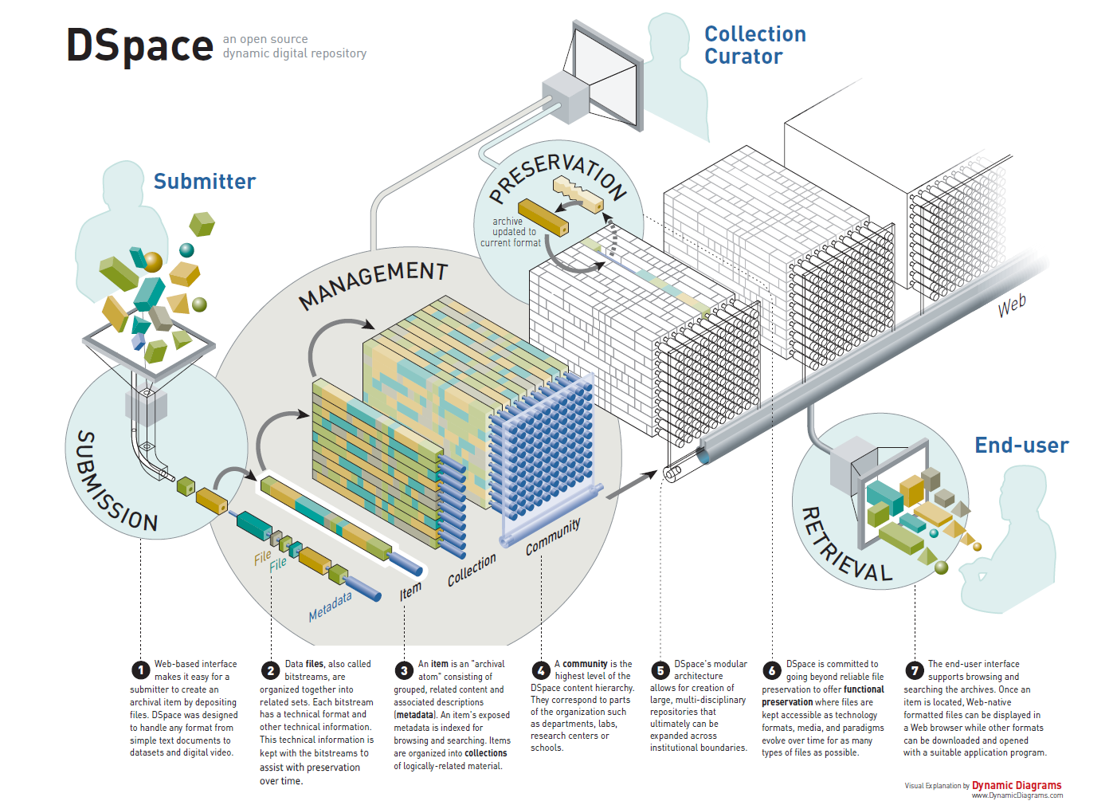
Notes:
Submission
Related files and metadata grouped into an item
Related items are grouped into a collection
Related collections are organized into a community
Curators manage these communities, collections, and items
End users access content via Web

Slide 13
Hardware Requirements
Recommendations
  Vary depending on scale [ref]
Our Specs:
  VMware Guest
  Xeon 2.2GHz
  4GB RAM
  250GB HDD
Notes:
Our specs were chosen based on the DSpace documentation's mid-range suggestions

Slide 14
Software Requirements
OS
  Linux/Unix
  Windows Server
  Mac OSX
Web server
  Apache Tomcat
  Jetty
  Resin
Relational database
  PostgreSQL
  Oracle
Our IT dept. req'd Windows Server 2012
Notes:
Very good chance your existing infrastructure will run DSpace

Slide 15
Human Requirements
  Developer
    HTML, CSS, JavaScript
    Bonus: Java
    Bonus: MVC framework experience
  System Administrator
    Install DSpace
    Configure DSpace
    Manage DSpace, OS, Server software

Slide 16

Customization
XMLUI built on Apache Cocoon framework
Three tiers
  Style
    Low entry
    CSS, XHTML
  Theme
    Mid entry
    XSLT, XHTML, CSS
  Aspect
    High entry
    Java, XSLT
We currently work within these two tiers
JavaScript is easier!
Notes:
Upcoming changes to the UI have prevented me from delving too deeply into UI changes on tiers 2 and 3.

Slide 17
System Maintenance
DSpace software updates
More customizations ("Can we do..?")
OS Updates and general server maintenance
Backup

Slide 18
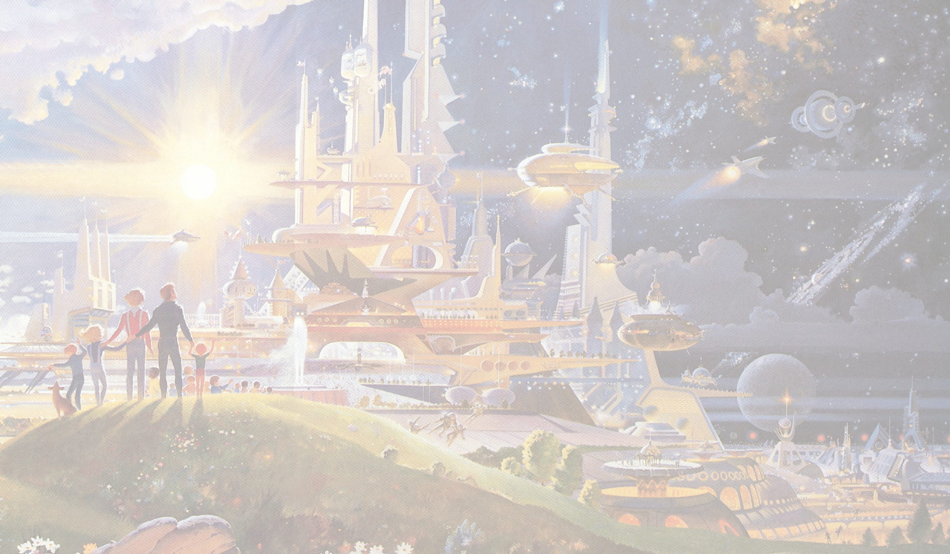
Future of DSpace
Active development
Better modularity/pluggability
Maturing API
Modern development framework (Angular 2)
Easier Install!
Artwork: Robert McCall

Slide 19
MCStor Overview

Slide 20
Benefits of MCStor
Open Access
Preservation
Scholarly Communication
Author Rights

Slide 21
Organization
MCStor is organized by communities and collections.
A community may represent an academic school or department, campus activity or group, etc.
A collection is a group of related digital items held in a community.
An item is a digital file held in a collection.

Slide 22
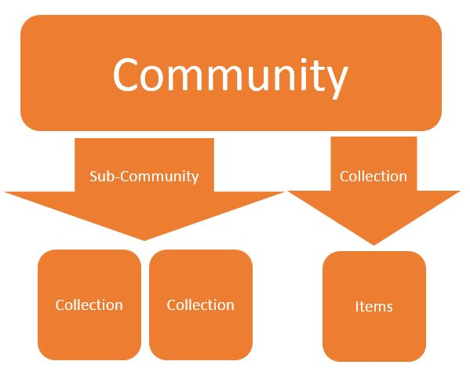

Slide 23

Demo
Libraries
P.H. Welshimer Memorial Library & Emmanuel Christian Seminary Library

Slide 24
Collaboration & Outreach
Engage with students and faculty.
Identify curriculum requirements / annual projects.
Host a workshop.
Take advantage of international initiatives, such as Open Access Week, to promote your IR.

Slide 25
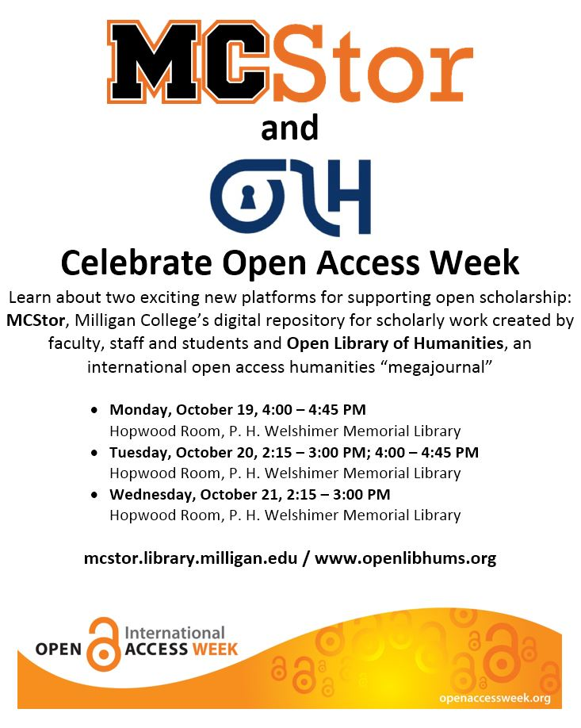

Slide 26
Future Projects
Milligan College Archives and Special Collections
Video and Audio files
Faculty Research
OCR Workflow (We'd love to hear your recommendations!)

Slide 27
Questions?

