Slide 1

Revitalizing Scripture Songs for Relevance
in Children’s Ministry Today
A MUSC 499 Undergraduate Research Project
April 15th, 2021
Michael Nickens
Faculty Mentor: Dr. Kellie Brown
Notes:
(don’t share screen yet)
Good afternoon, everyone. My name is Michael Nickens, and I am a Piano Performance and Children’s Ministry double major from Kingsport, Tennessee.
Since the summer of 2020, I have been working with Dr. Brown to complete a 499 Undergraduate Research project that combines my love of music and ministry.

Slide 2
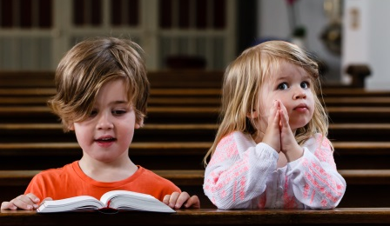
Research Project Overview
Collecting
Transcribing
Composing
Notes:
This project centers around the effective use of song to teach scripture verses to children.
Back in the Spring of 2020, Dr. Ted Thomas, former German and Humanities professor here at Milligan, talked with me about a part of his ministry that he wanted to pass on.
If you have ever had the pleasure of visiting Oak Grove Christian Church when Dr. Thomas was the minister , you will know about the special children’s ministry portion of the service. Dr. Thomas invites the children down to the front and leads them in singing memorized scripture verse songs. Most of these songs do not exist in written form. Many were composed by Dr. Thomas’ father and have been passed down over the years by an oral tradition. So there is a need to collect these songs and then transcribe them into a written format so that they can be preserved and made more widely available for children’s ministry.
Dr. Brown and I also thought that it would be interesting to take one of the melodies of the songs and compose a piece for string quartet.

Slide 3

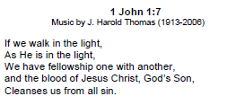
Collecting
Notes:
So the first part of the research process was to collect the songs. To accomplish this, Dr. Thomas recorded himself singing each of the songs and sent me the recordings along with the accompanying scripture verses. I think began to make a chart and explore any copyright issues that might exist. There were over 80 songs submitted and Dr. Brown and I chose 8 of those to transcribe.

Slide 4
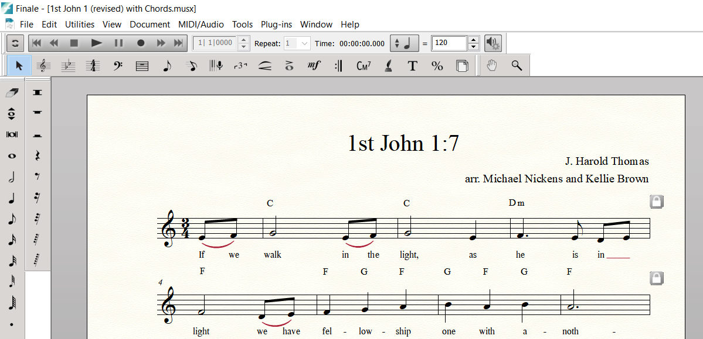
Transcribing
Notes:
The second step of the process was to take the audio files and transcribe them into a written format. I used a notation software called Finale. Dr. Brown and I met regularly to go over the transcriptions. I discovered that it is often quite difficult to take a song that has always been sung in an oral tradition and make it fit neatly into our Western notation system. Sometimes compromises had to be made especially in terms of rhythm. That ended up being the greatest challenge of the project. I also wanted to include guitar chord symbols so that simple accompaniments that were practical in a church setting could be added.

Slide 5
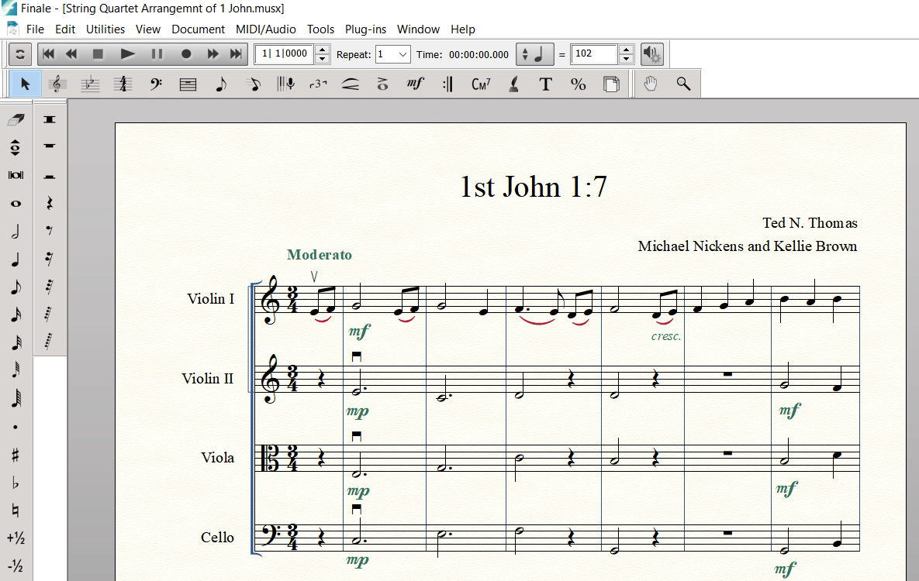
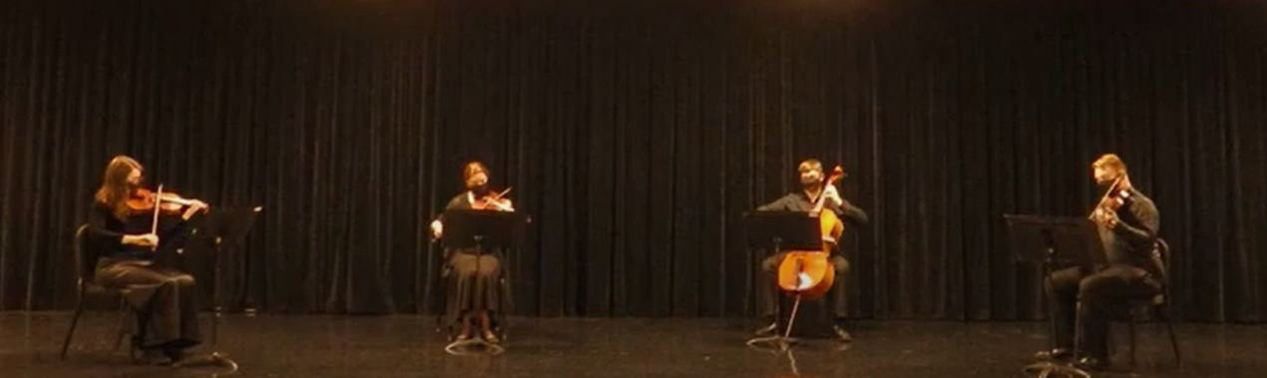
Composing
Notes:
As I was working on transcribing the scripture songs, I also selected one of the melodies to compose a piece based on it for string quartet. I chose 1st John 1:7 for my arrangement, since I felt that it best suited a string Quartet. You will hear in the recording that the melody has a Waltz like feeling. The melody fits well for the strings, and it allows for them support for eachother in the music
Since live performances are difficult during the pandemic, I have recorded two of the scripture songs with Matthew Haagen providing guitar accompaniment and I have also recorded the Milligan String Quartet performing the newly composed work. So here are those performances.
Final Words: I want to thank the time for Dr. Brown and Dr. Ted Thomas. Alll of this would have never been possible without their help and guidance. I also want to thank Professor Cheryl Fitzgerald, Matthew Haagen, and the Milligan String Quartet for thier invalubale work on this project.

