Slide 1
Sensory Processing Disorder
By Sadie Bradshaw, OTS

Slide 2
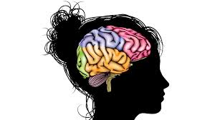
What is Sensory Processing?
Our brain’s ability to take in information from our 7 senses, organize and interpret this information to respond to the world in a meaningful way.
Sensory processing is the way we learn about the world and function effectively.

Slide 3
What is Sensory Processing Disorder?
A neurological disorder where the sensory information the individual perceives results in abnormal responses.
It causes difficulty, or inability to function in daily life.
Notes:
Unlike people who have impaired-sight or hearing, those with SPD do detect sensory information. The information gets “mixed up” in their brain which can lead to inappropriate responses.
Pioneering occupational therapist, psychologist, and neuroscientist A. Jean Ayres, Ph.D., likened SPD to a neurological “traffic jam” that prevents certain parts of the brain from receiving the information needed to interpret sensory information correctly.

Slide 4
SPD continued
3 types
  Sensory Modulation Disorders(SMD)
  Sensory Based Motor Disorder (SBMD)
  Sensory Discrimination Disorder (SDD)
SMD is most commonly seen and discussed
Notes:
We will focus on SMD for this lecture, just making aware of other diagnosis under SPD

Slide 5

How common?
Used to be 1 in 20, now considered 1 in 16
  That is one child in every class.
Autism Spectrum Disorder 9 in 10
HAS to impact function in daily life
We all have a little sensory problems
Notes:
1 in 16 typically developing child. What about ASD Population? That is more like 9 out of 10.

Slide 6
Associated problems
“That some people with autism have some degree of SPD is a recognized fact” (Kranowitz 2005)
Premature babies, orphanages, highly deprived of sensory opportunities at a young age, autism, highly gifted children, fragile X, mild cerebral palsy

Slide 7
Causes
Exact cause is unidentified
Thought to be inherited
Prenatal and birth complications
Environmental factors
Notes:
Prenatal- Chemicals, medications, toxins, smoke, drugs, alcohol, great emotional stress, virus, chronic illness or problem with the placenta
Birth-multiple births at once, emergency cesarean section, lack of oxygen, surgery soon after birth
Postnatal- environmental pollutants, child abuse, not enough stimulation of senses from limited interaction and play, lengthy hospitalization, and placement in an orphanage.

Slide 8

Our 7 senses
Visual
Olfactory (smell)
Gustatory (taste)
Tactile (touch)
Auditory (hearing)
Proprioception( body awareness/deep pressure)
Vestibular (movement/balance)

Slide 9
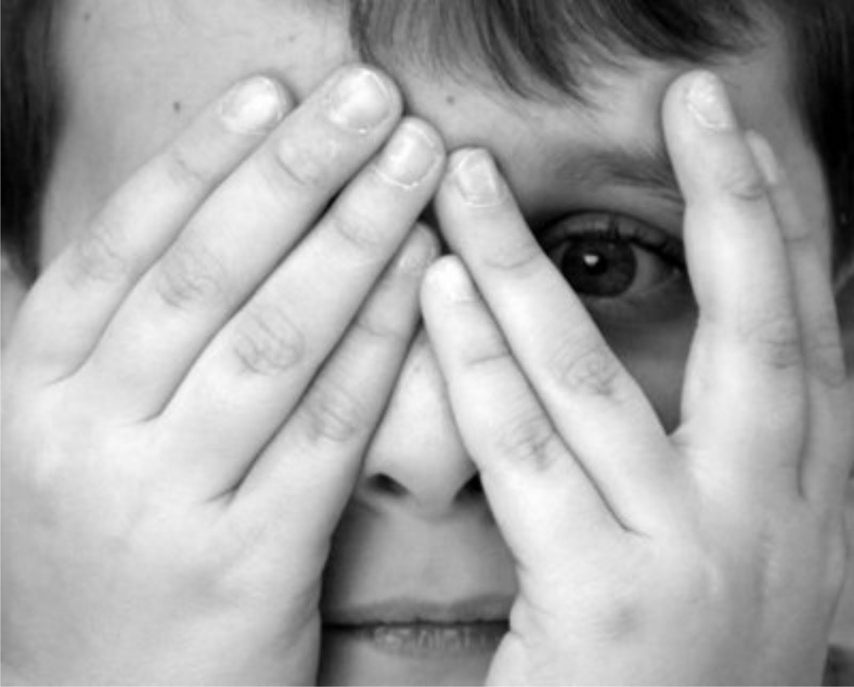
Imagine if:
You could not tune out that flickering light in the classroom
The buzzing of the refrigerator in the next room made you lose sleep every night
Every time you try to write with your pencil you push too hard and break it.
Every time someone touches you it feels like sandpaper on your skin
Notes:
OR the tag on the back of your shirt itches and feels uncomfortable.
OR sitting for 15 minutes makes you have to run around because your muscles feel like they are going crazy or your body is unaware of its location in space so deep pressure helps.

Slide 10
Problem areas related to SPD
Self-care ex: Feeding
Delayed speech development
Poor attention span or difficulty focusing
Unusually high or low activity level
Oversensitivity to touch, sights, or sounds
Notes:
Emphasize feeding and Speech as this is SLP Targeted lecture.
Delayed speech=not motor, maybe auditory
Coordination/muscle problems- clumsy child, weak or stiff. Distally strong, proximal weak (core)

Slide 11
3 categories of Sensory Modulation Disorder
Sensory Avoiders
  Over-responsive
  Respond too much
Sensory Seekers
  Craving more
Sensory under-responders
  Respond too little
  Difficult to treat and more uncommon
Notes:
*talk about tests done on children with feather. Sensory avoiders high response all the time. Sensory seekers have low response and need more stimulus to reach normal. Sensor under-responders will not respond no matter how much stimuli is presented.

Slide 12
Sensory Avoiders Red flags
Fight: aggressive or forceful behavior in response to sensation
  Hitting, biting, kicking
Flight: flea situations
Freeze: may completely shut down
Could try and talk their way out of activity that includes the over stimulating sensation
Respond as painful or irritating
Notes:
*discuss fight or flight and how that is incorporated in real fear of these sensations.
*fleaing could be shutting down

Slide 13
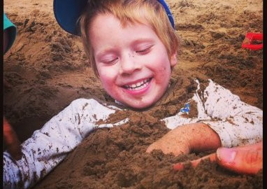
Sensory Seeker Red Flags
Obvious craving for sensory inputs
Never seems satisfied
May look like ADHD

Slide 14

Sensory under-responder Red Flag
Will give less of a response to sensory stimulation than peers
May need stronger input than peers
Reactions may appear slow
May appear lazy or disinterested

Slide 15
Combinations
7*7*7=21 different areas
Can be an avoider in one sensory input and a seeker in another sensory input
  Most common: tactile avoider and vestibular seeker
Can be seeking, avoiding, under-responsive in different sensory inputs
  Most Common: proprioception seeker and vestibular seeker
Notes:
Autism spectrum: most common is proprioceptive seeking with some other things. With auditory avoidance or seeking or vestib seeking

Slide 16
Most Common SMDs
Vestibular(movement) Seekers
Auditory Seekers
Auditory Avoiders
Proprioception (body awareness/deep pressure) Seekers
Tactile Avoiders (tactile defensiveness)

Slide 17

Remember…
Not every symptom will appear in every client
They have good days and bad days
Likely to have problems with more than one sensory input

Slide 18
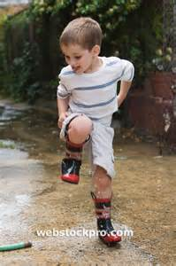
Proprioception Seekers
Crashing into things/slams doors
Pushes heavy objects
Stomps feet down the hallway
Aggressive behaviors
  Hitting, biting, kicking
Chews on shirt collar, sleeves, or non-edible objects
Likes tight clothing and shoes

Slide 19
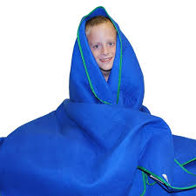
Proprioception Seeker Suggestions
Jumping on mini trampoline
Pushing therapist on swing
Crash pad breaks
Play dough or clay activities
Wear weighted back packs or weighted blankets
Focus on seating for child
  Bean bag vs hard back
  Keep feet on floor when seated
Notes:
*add difference between bean bag vs hard

Slide 20
Tactile avoiders
Avoid messy situations or want to wash hands immediately
Restricted eaters
Grooming or bathing can be difficult
Do not want physical affection
  Kissing, hugging, holding hands
Extreme behaviors to light touch and/or certain textures

Slide 21
Tactile Avoider Suggestions
PEP:
  Look, touch, kiss, eat progression
Use firm touches, pats or hugs
Do not force touch
Use food play and be a model
Do not surprise child
Decrease lighting and lower your voice
Talk less

Slide 22
Vestibular Seekers
May be unable to sit still
Loose floppy body “wet noodle”
Can appear as ADHD
  Some children will have ADHD, but do not rely on this!
May appear recklessness or take safety risks
Seem impulsive
Repeated shaking of head, rocking back and forth, jump up and down
Intense movement experiences
  Bouncing, flipping, spinning

Slide 23
Vestibular Seeker Suggestions
Consider developmental level with movement
  Ex: A toddler 3-4 min vs elementary can sit quietly a max of 15-20 min
Movement breaks are important!
Change the movement activities on a regular basis
Use Big transition movements
  Bug crawls, animal walks, hop, skip, march
Notes:
*With movements like rocking it can be slow and calming, but bouncing or running will alert the client. It is important to know that each child will be different, and have different sensory needs. Based on those needs you can determine if a child needs to calm or alert during mealtime.
*this is important to keep in mind when doing a session with any child

Slide 24
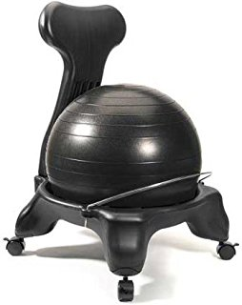
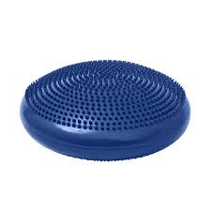
Seating Options for Movement
Notes:
Why it is important- allows them to sit but still move, ball chair

Slide 25
When swinging (vestibular)
WATCH OUT FOR:
Excessive giggling, yelling, or talking
Excessive movement on the swing
Turning pale or sweating
Marked mood swings following stimulation
Notes:
Tone down and put up with vestibular
What are you using swing for? Swings (vestibular stimulation) used to feed their sensory, but be an observer
Be aware that vestibular input can quickly overwhelm

Slide 26
How to respond to Overstimulation
Slowly stop input/swinging
If child is dizzy do heavy work activity
  Push ups, hopping
Help child breath deeply and slowly
Provide deep pressure (Ex. Bear hugs)
Focus on one object that is not moving until dizziness stops
Notes:
Move it up

Slide 27
Auditory Seeker
Talks very loud
Seeks loud noises
Holds musical objects to ear
Will clap, sing, or slam loudly
More common with autism

Slide 28
Auditory Seeker suggestions
Use noises as rewards
Do not use ear plugs
Use music in therapy
  Listen to tape or CD
  Sing a song with hand motions

Slide 29
Auditory Avoiders
Oversensitivity to noises
  Vacuum, thunder, train whistle, siren, horn or loud room, air conditioning
Express excessive emotions with noises
May put fingers in ears to drown out noises
May yell to drown out noises
Very typical with autism

Slide 30
Auditory Avoiders Suggestions
Differentiation between sounds may be difficult for child
When using music:
  Rhythmic or steady beats
  Watch the level and other stimuli in room
  Background music is not recommended
Private areas and breaks from noise
Ear plugs, headphones or earmuffs
Notes:
*don’t have a lot of music or background noise

Slide 31
Suggestions for all
Prevention of sensory based behavior
Watch for overstimulation or seeking behaviors
Read cues and give breaks as needed
Use breathing
  Breath in 4 counts, hold it, breath out 4 counts
Notes:
We want to catch before they loose it. That is the art, and observation is key. What is precursor because once they blow it is very hard to get them to a learning spot

Slide 32
References
Ernsperger, L., & Stegen-Hanson, T. (2004). Just take a bite: easy, effective answers to food aversions and eating challenges. Arlington, TX: Future Horizons.
Isbell, C., & Isbell, R. T. (2007). Sensory integration : a guide for preschool teachers. Beltsville, MD : Gryphon House, ©2007.
Kranowitz, C. S. (1998). The out-of-sync child : recognizing and coping with sensory integration dysfunction. New York : Perigee Book, 1998.

