Slide 1

Promoting Archives for Milligan’s 150th Anniversary
Lindsay Kenderes
Information Resources Librarian & College Archivist
Milligan College

Slide 2
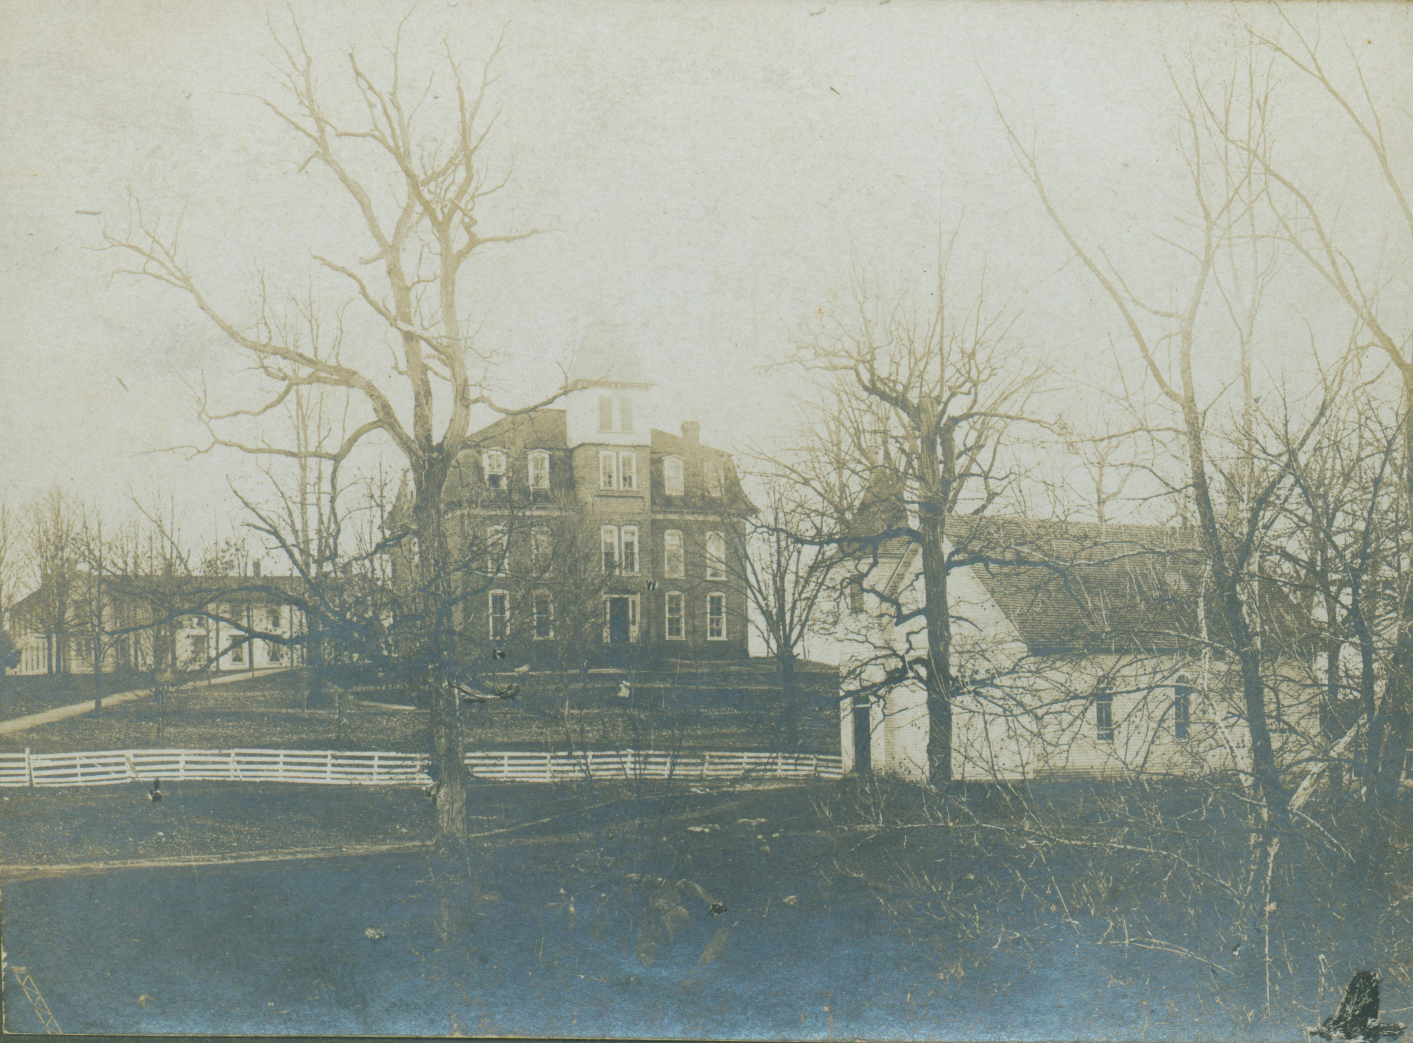
Milligan College and Buffalo Creek Christian Church, c. 1900
The Holloway Archives at Milligan College

Slide 3
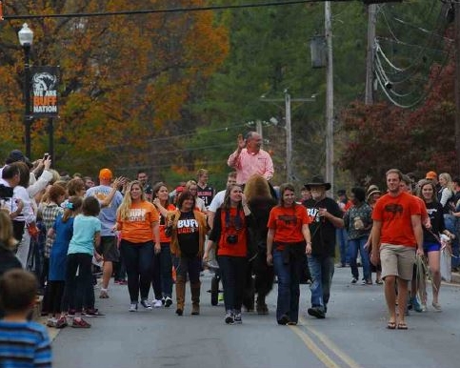
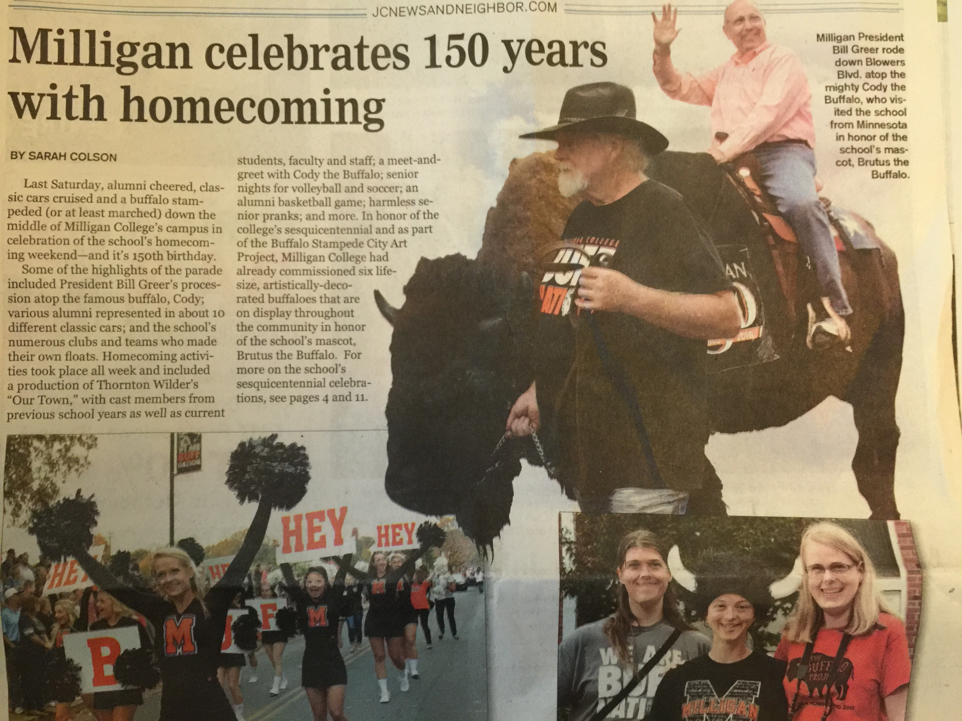
Johnson City Press
Johnson City News & Neighbor

Slide 4
When colleges approach an anniversary, college administrators, faculty and staff will rely heavily on their institution’s archives to provide materials that document their college’s history and they will want the opportunity to promote this history on campus and throughout the community.

Slide 5
Without the role of archives to preserve and create access to documents of years past, an institution would find it close to impossible to serve the needs and demands of celebrating an anniversary which is intended to connect their institution’s heritage with campus and the community.

Slide 6
Introduction
Scholarship, Community, Faith: Milligan Celebrates 150 Years commemorative book
Milligan Campus Scenes: Then and Now interactive photo exhibit
Forward with Faith: The Milligan College Story theater production
History Through the Eyes of Milligan faculty lecture series
Archive exhibits, on campus and digital

Slide 7
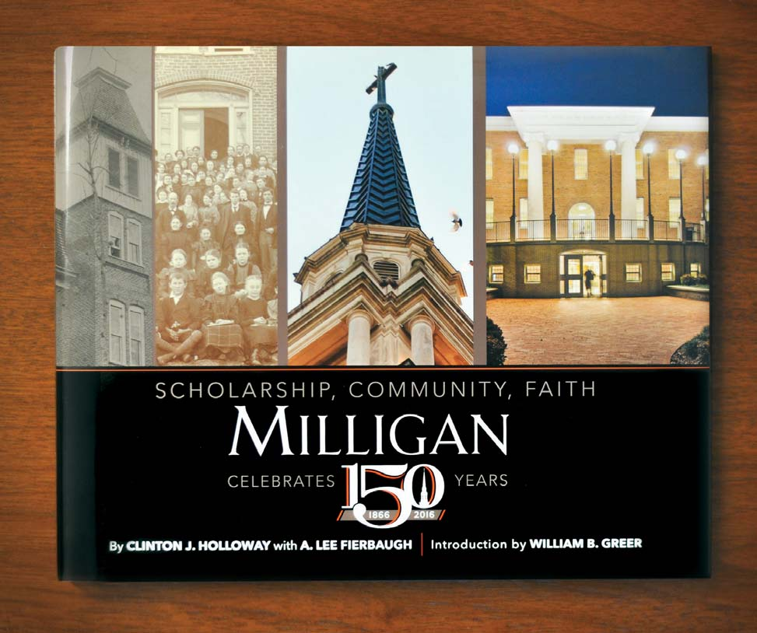
Scholarship, Community, Faith: Milligan Celebrates 150 Years
By Clinton J. Holloway with A. Lee Harrison (Fierbaugh)
Faith, Arts & Culture 2016-2017 Brochure

Slide 8
Scholarship, Community, Faith: Milligan Celebrates 150 Years
2015
February – Archive collaboration/Selection begins
March – Photoshoot (Krista Knudsten and Art Brown)
March-April – Digitize at high resolution
April – Provide scans to Art Brown for layout design
July – Book sent for publication
October – Book Signing at Homecoming

Slide 9
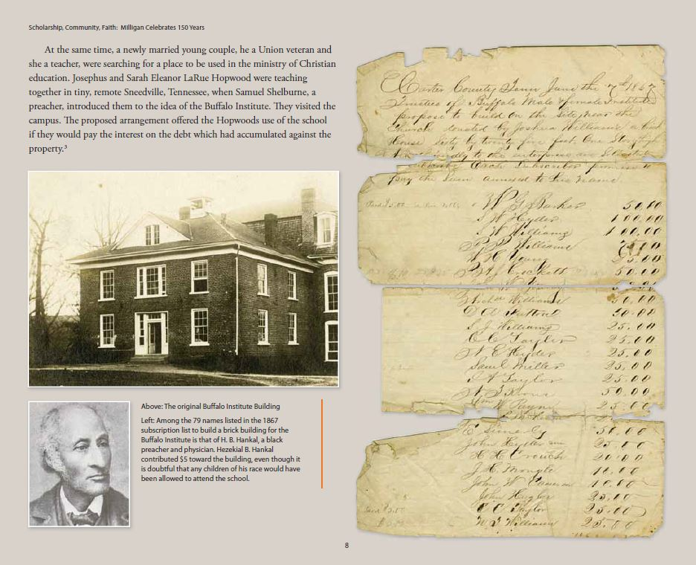
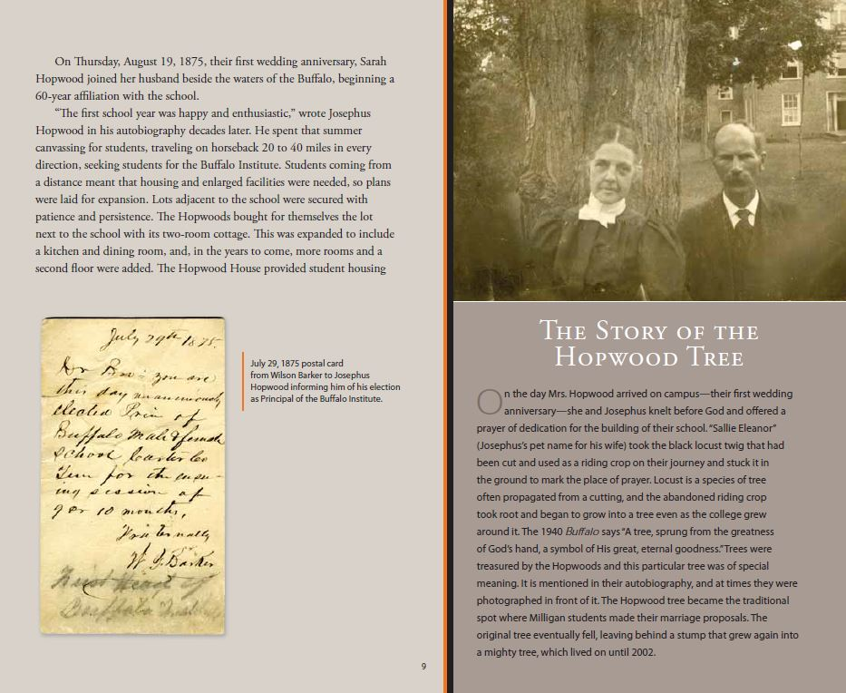
Scholarship, Community, Faith: Milligan Celebrates 150 Years

Slide 10
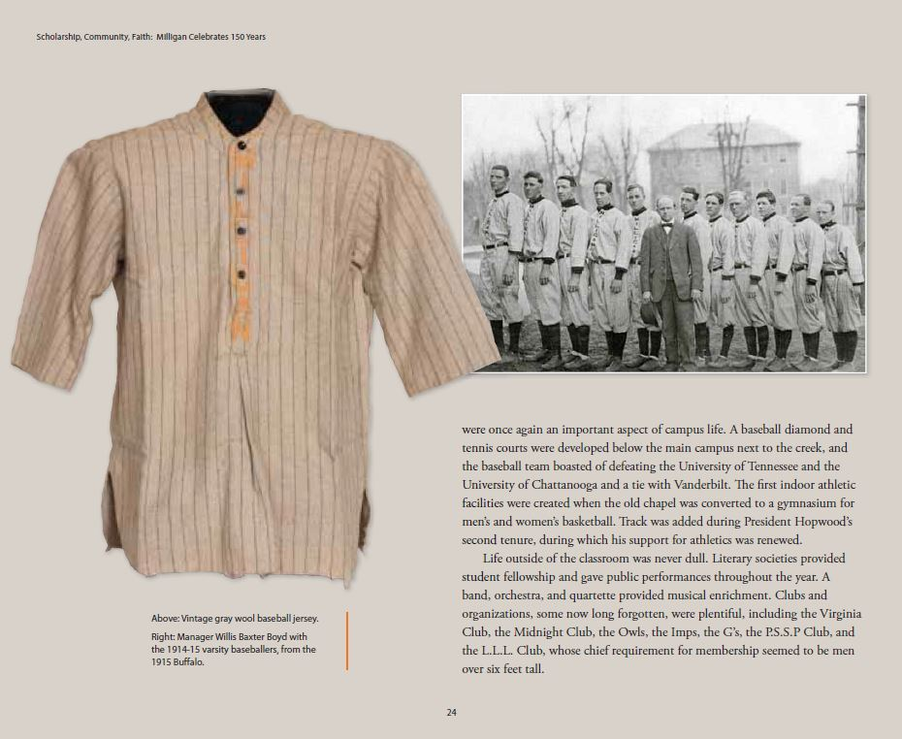
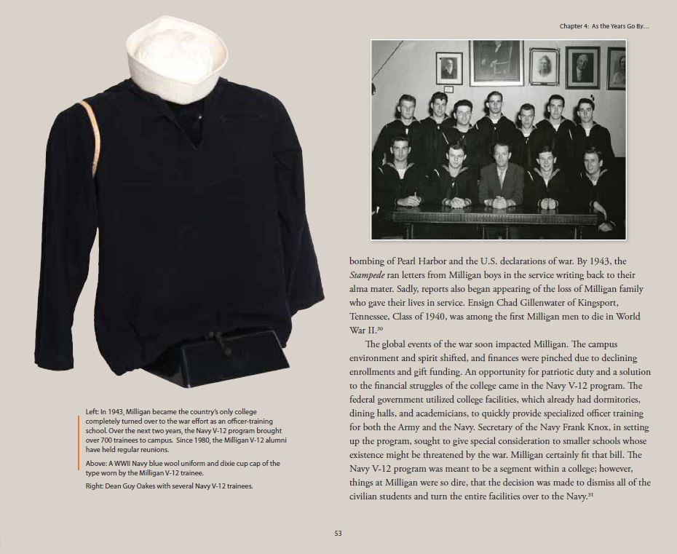
Scholarship, Community, Faith: Milligan Celebrates 150 Years

Slide 11
Faith, Arts & Culture 2016-2017 Brochure

Slide 12
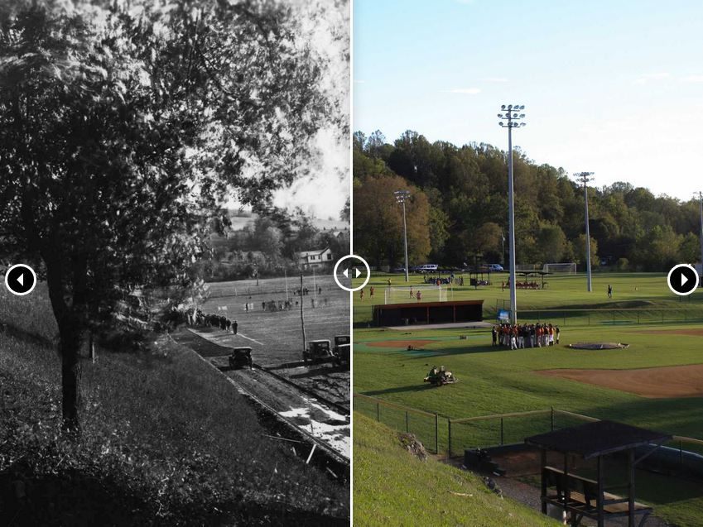
Milligan Campus Scenes:
Then and Now

Slide 13
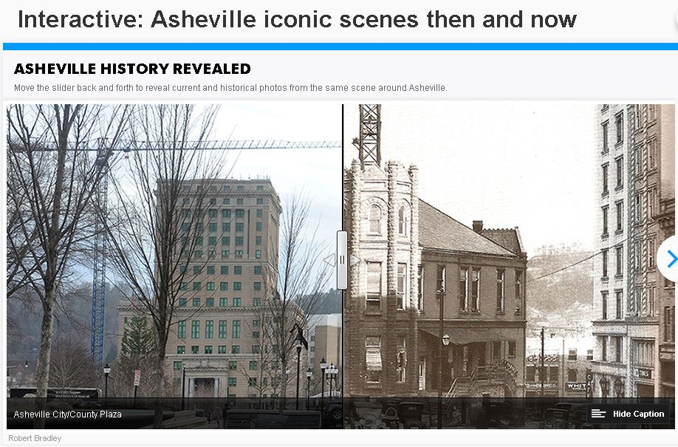
Citizen-Times, Asheville

Slide 14
Milligan Campus Scenes:
Then and Now
The purpose of this project was to capture present day photos to match originals from the Archive to create a digital, interactive photo display of past and present campus scenes to be accessed online on the Milligan Libraries website. This display is being used celebrate the 150th Anniversary of Milligan College.

Slide 15
Milligan Campus Scenes:
Then and Now
2015
August – Technical requirements/Select photos
September – Introduce student to project
September-October – Photograph campus
November – Receive photos from student
2016
January – David Baker creates interactive display
February – Project live on Milligan Libraries site

Slide 16
Milligan Campus Scenes:
Then and Now
Technical tools:
TwentyTwenty (Interactive Slider)
http://zurb.com/playground/twentytwenty
Wordpress Plugin
https://wordpress.org/plugins/twentytwenty/
Wrapped it in a simple carousel to allow scrolling through different images

Slide 17
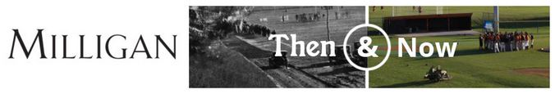

Slide 18
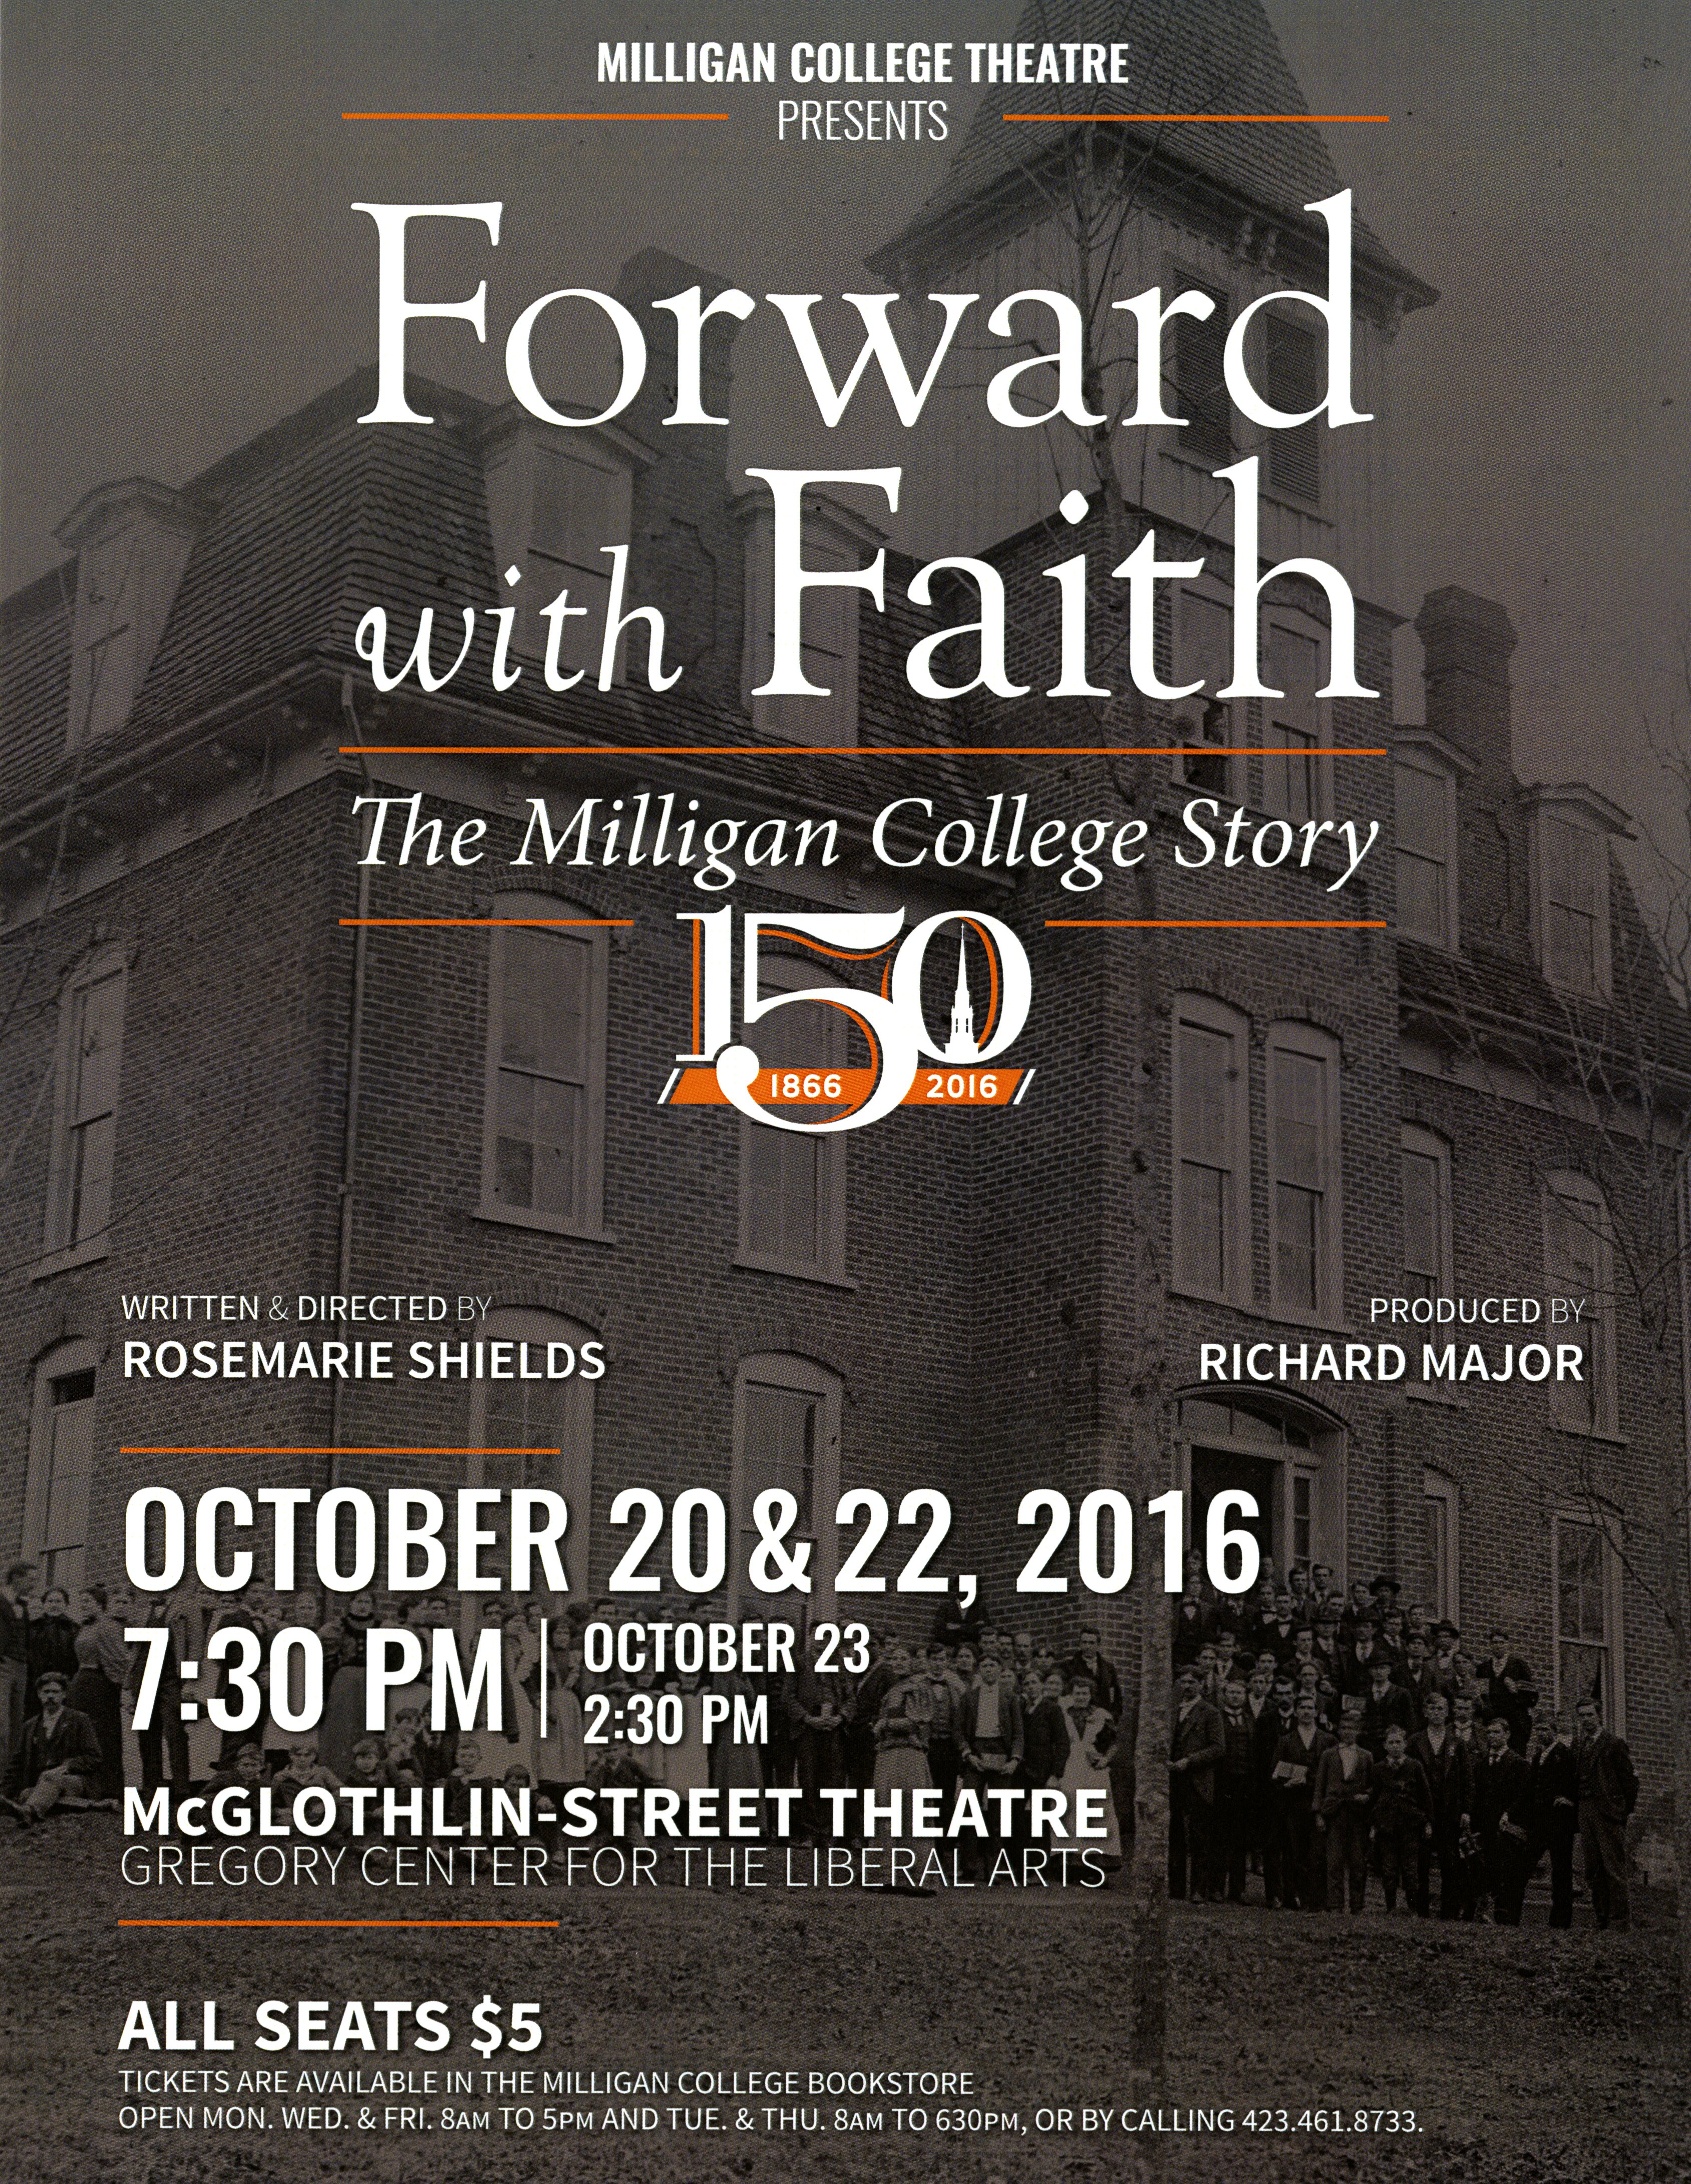
Forward with Faith:
The Milligan College Story
Written & Directed by
Rosemarie Shields
Produced by Richard Major

Slide 19
Forward with Faith:
The Milligan College Story
2016
April – Archive research visits / Select photos for stage design
May-August – Welshimer Library closed for renovations!
July-August – Script readings / history fact checking
September-October – Select archive video/music
October– Homecoming Weekend Performance

Slide 20
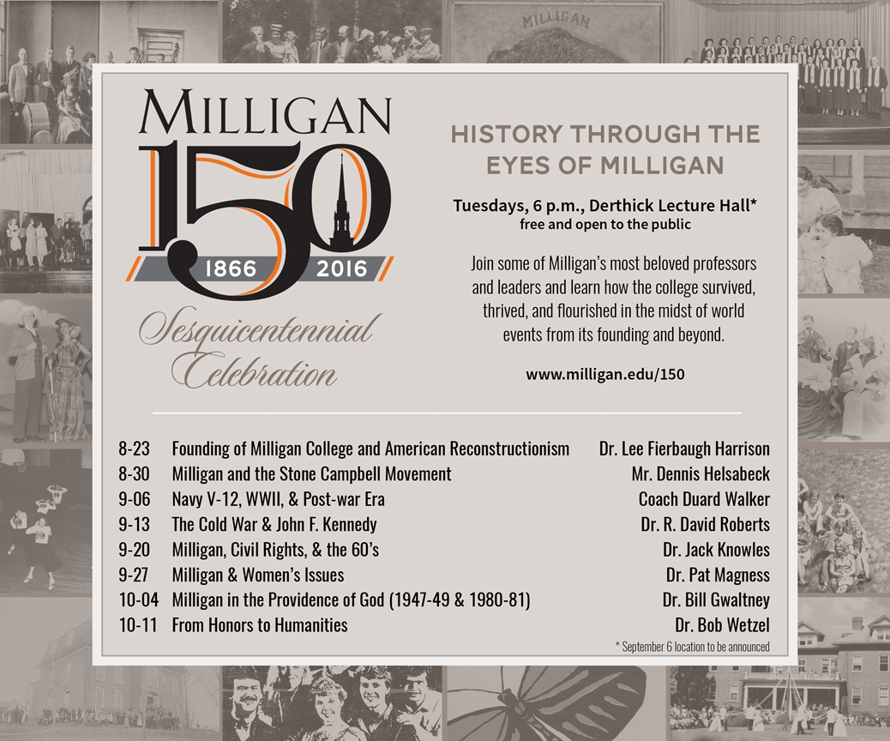
History Through the Eyes of Milligan

Slide 21
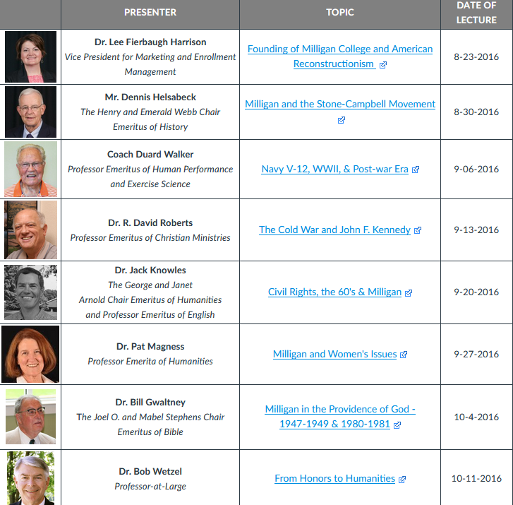

Slide 22
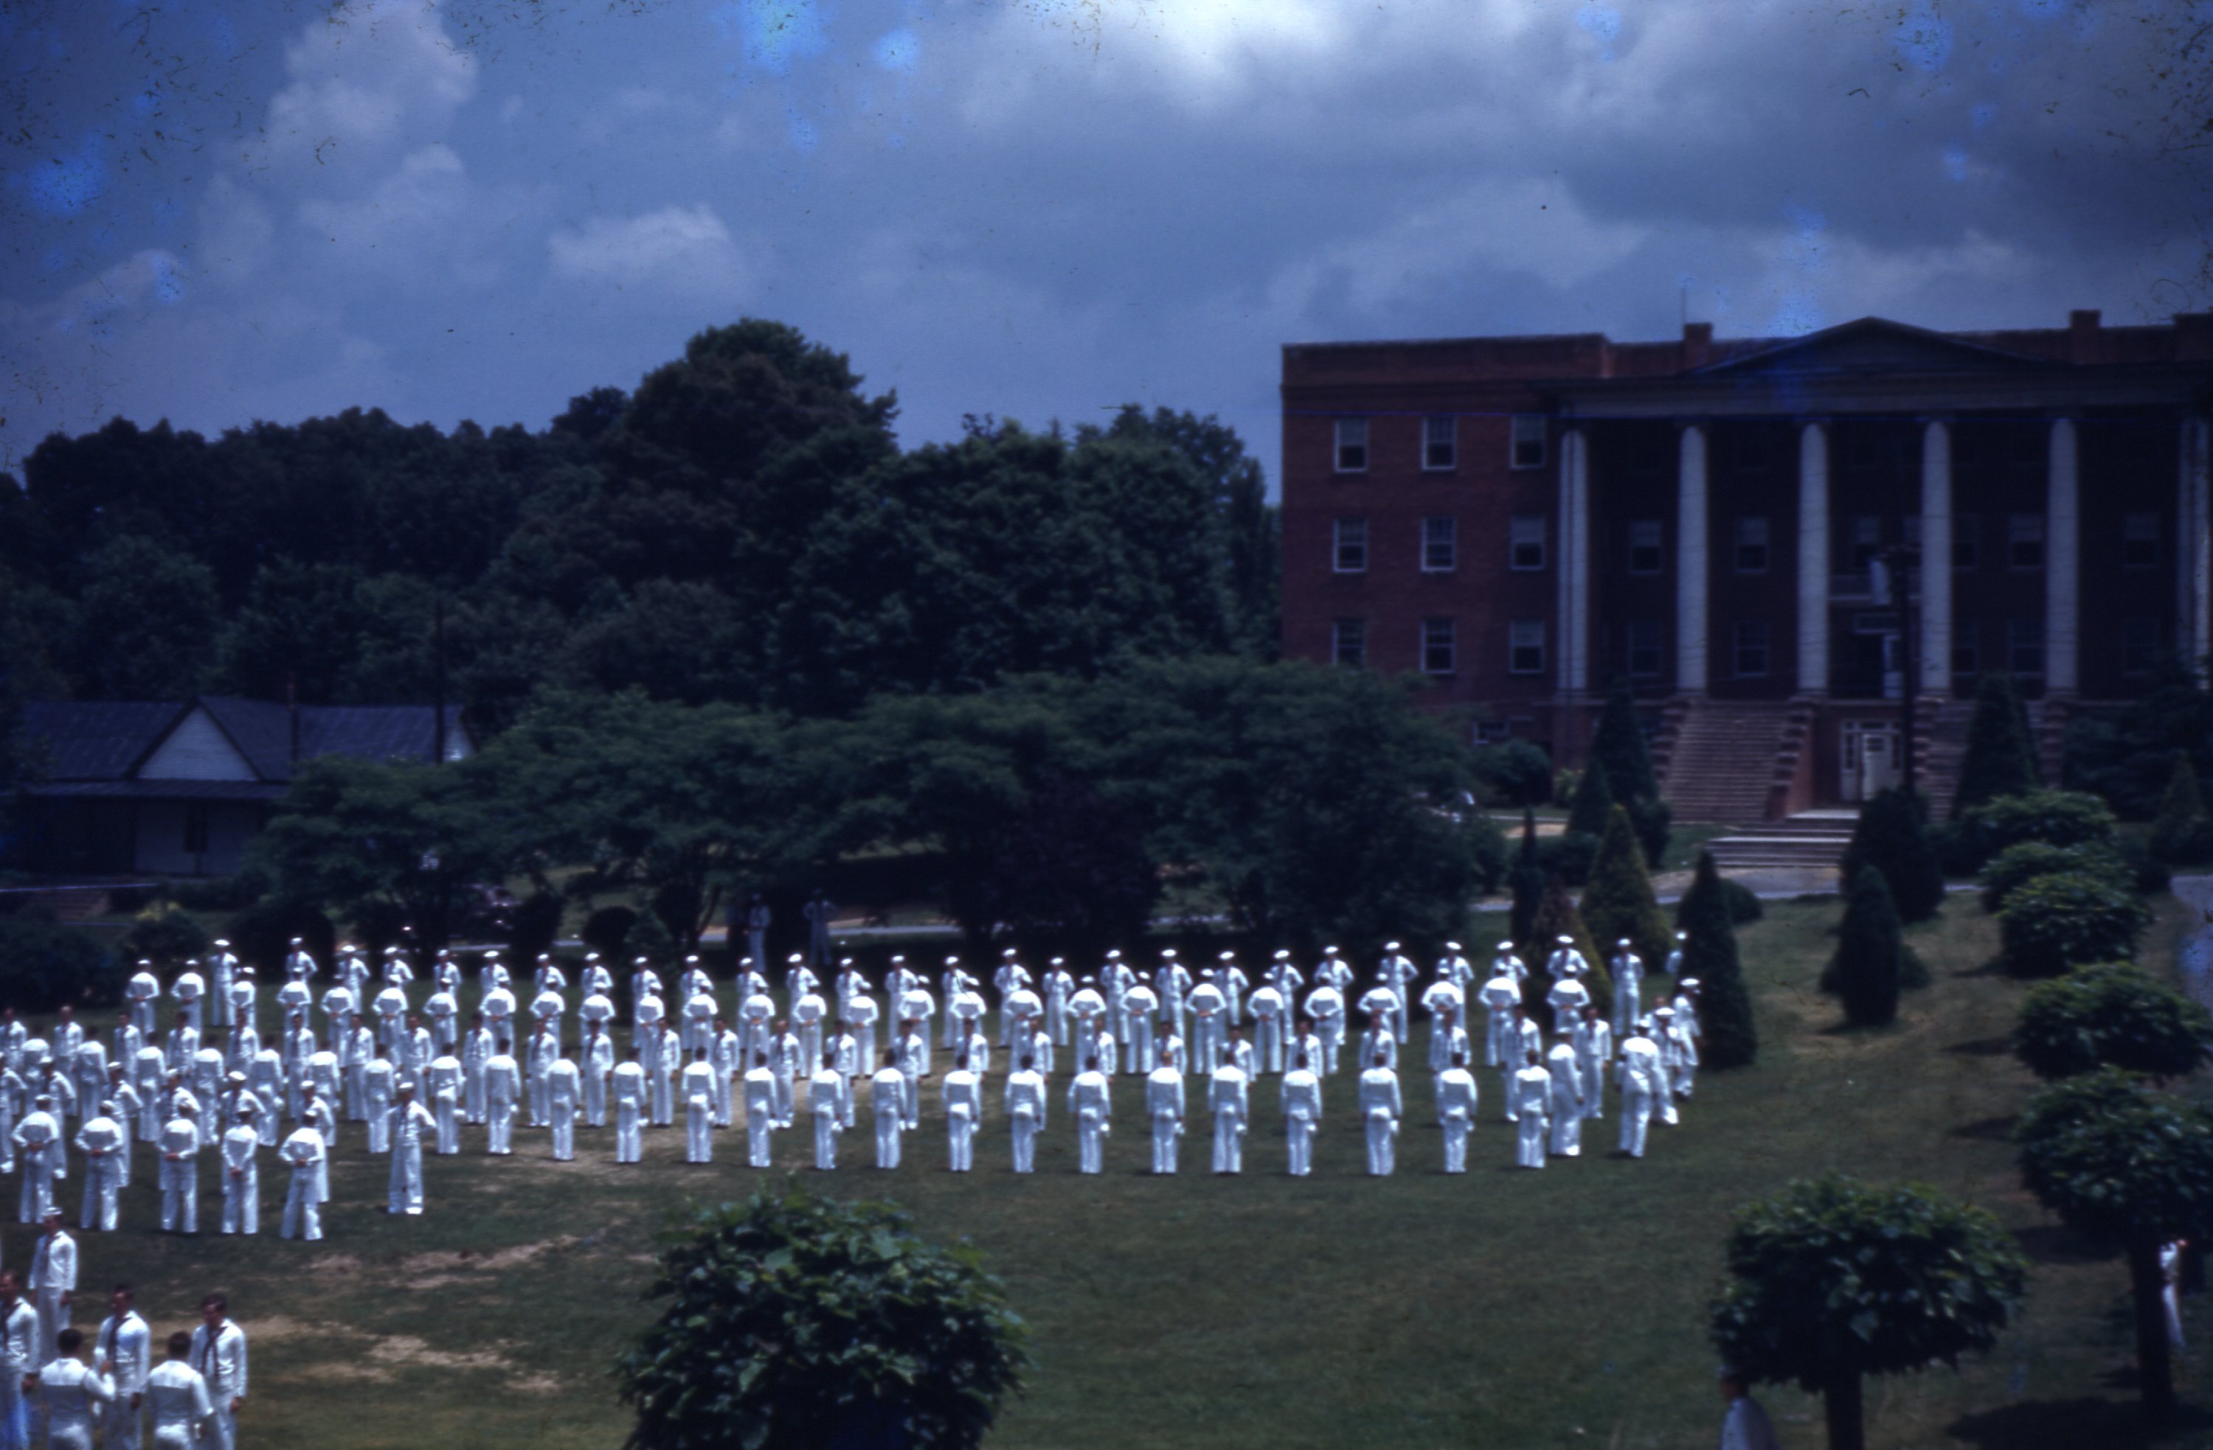
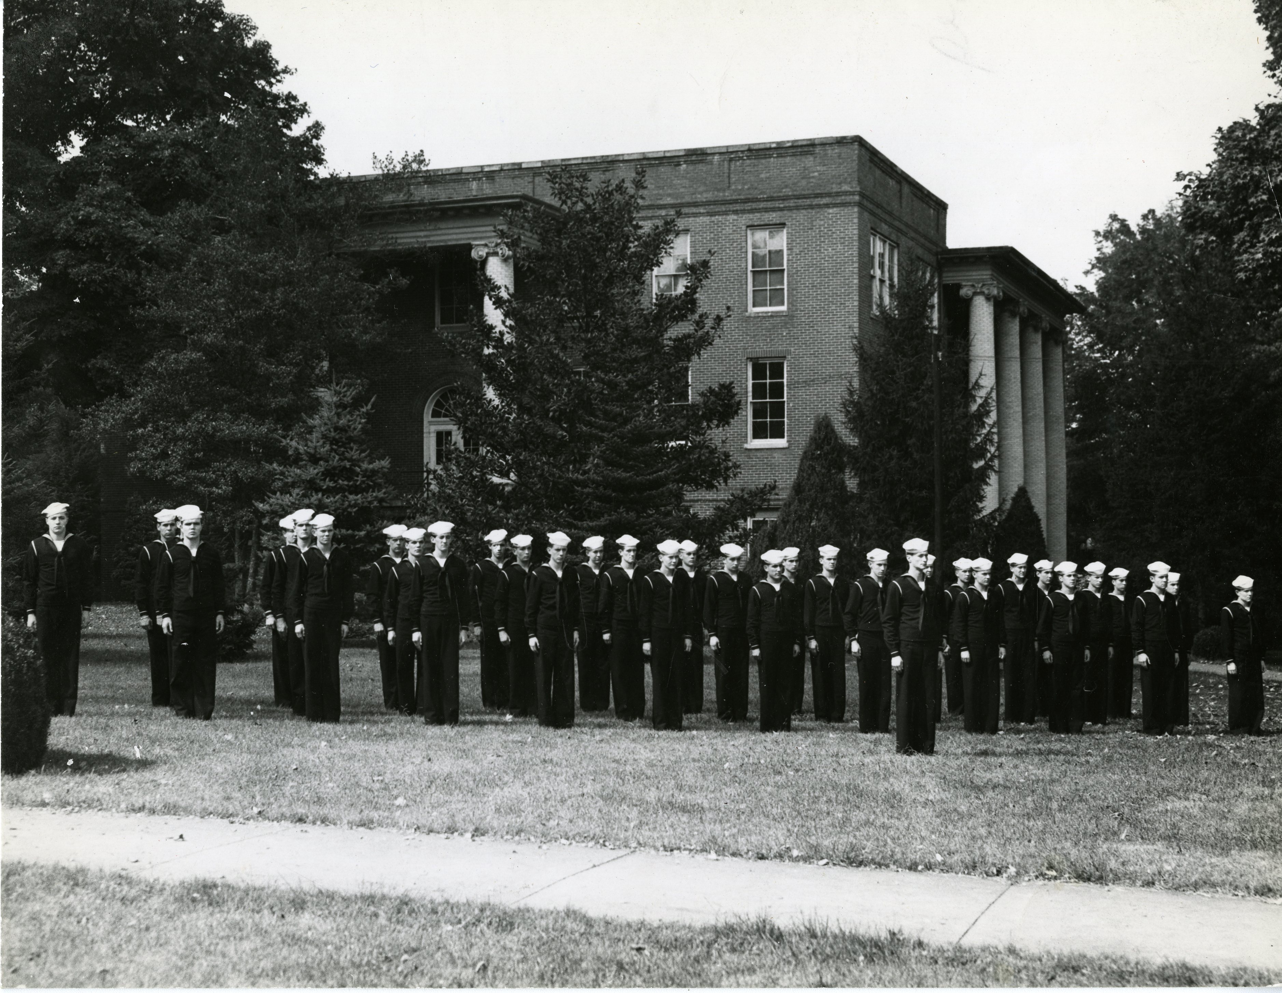
History Through the Eyes of Milligan
Navy V-12 Program
The Holloway Archives at Milligan College

Slide 23
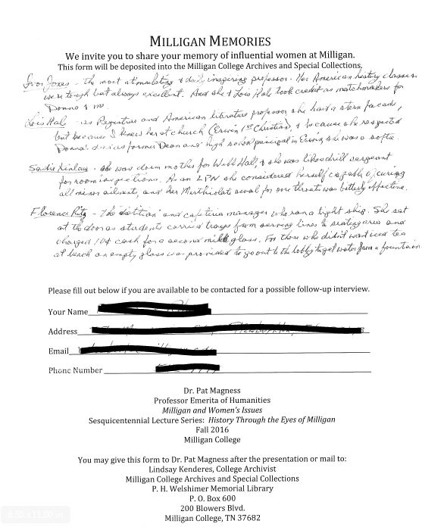
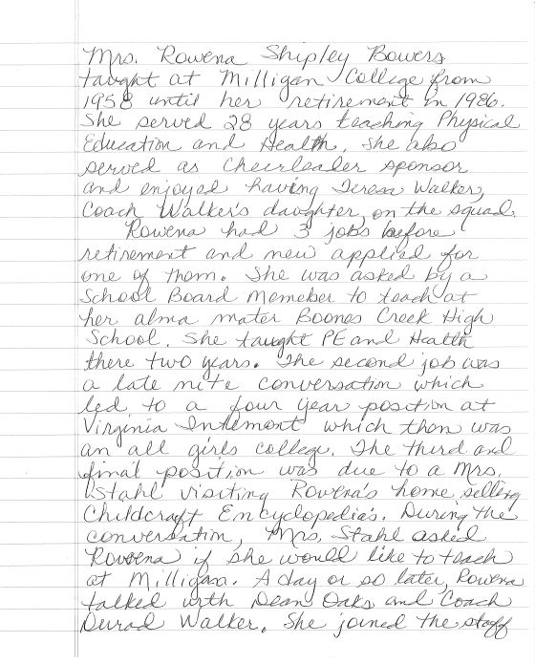
History Through the Eyes of Milligan

Slide 24
History Through the Eyes of Milligan
The faculty lecture series was created and organized by Garland Young, Tim Dillon and Burt Allen and was a great way to connect retired faculty back to campus and allowed them the opportunity to share their institutional history and memory with our community.

Slide 25
Archive Exhibits
Where the Buffs Roam: Milligan’s Campus through 150 Years
“Christian Education, the Hope of the World”: An Early History of Milligan College
Celebrating 150 Years of Milligan History and Memory

Slide 26
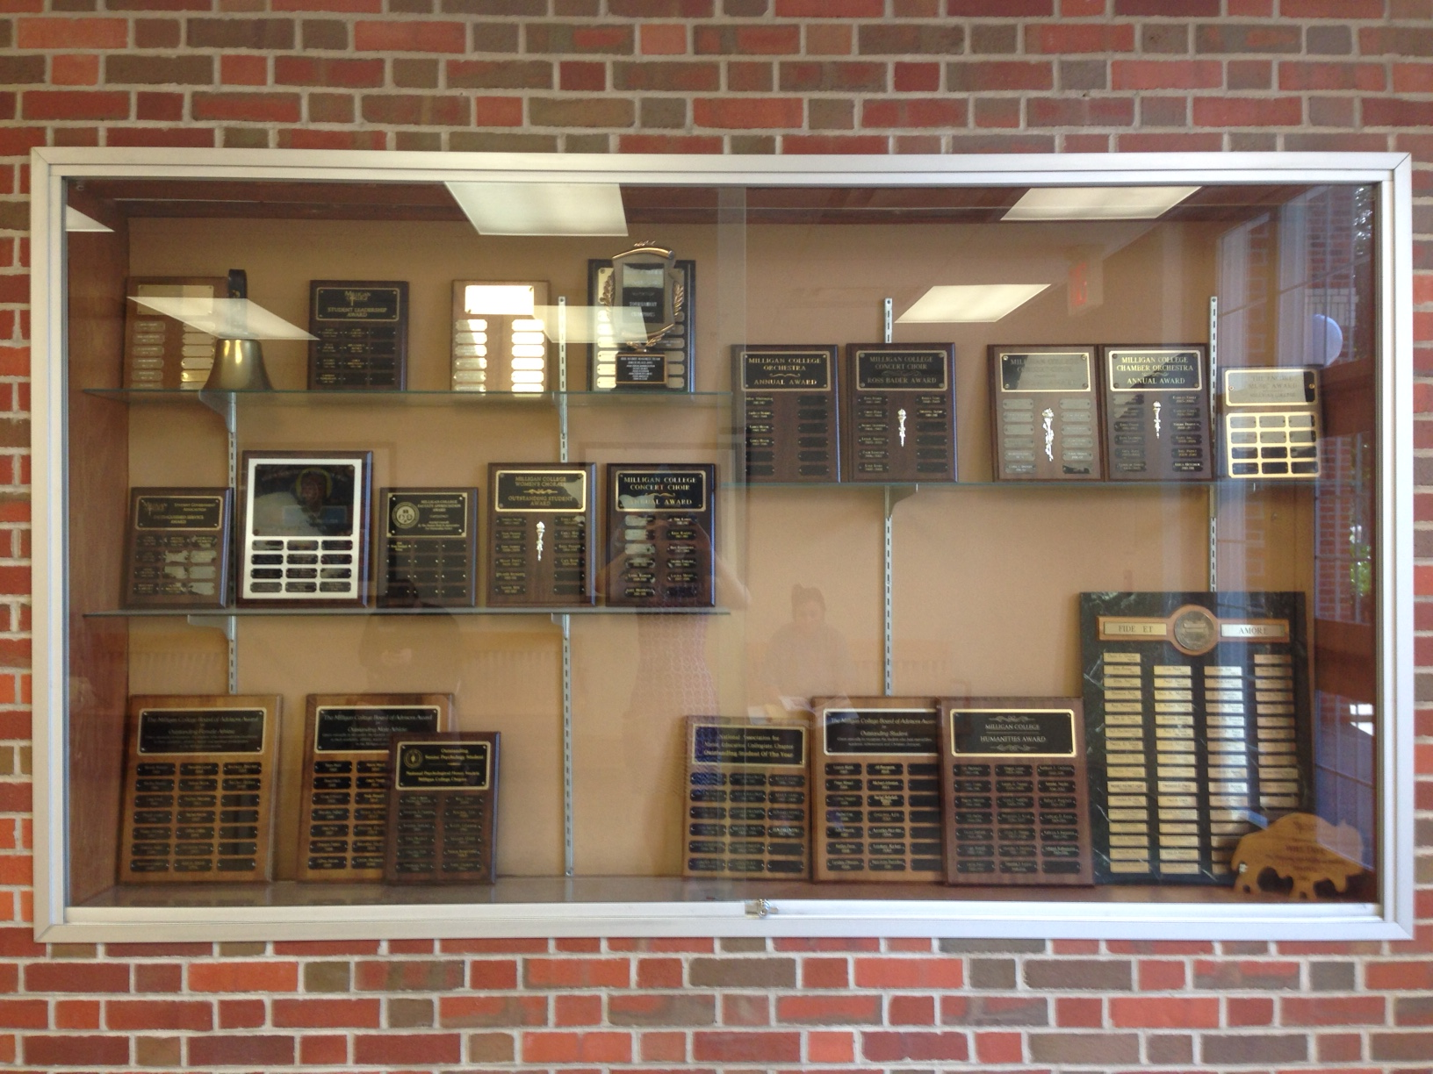

Slide 27
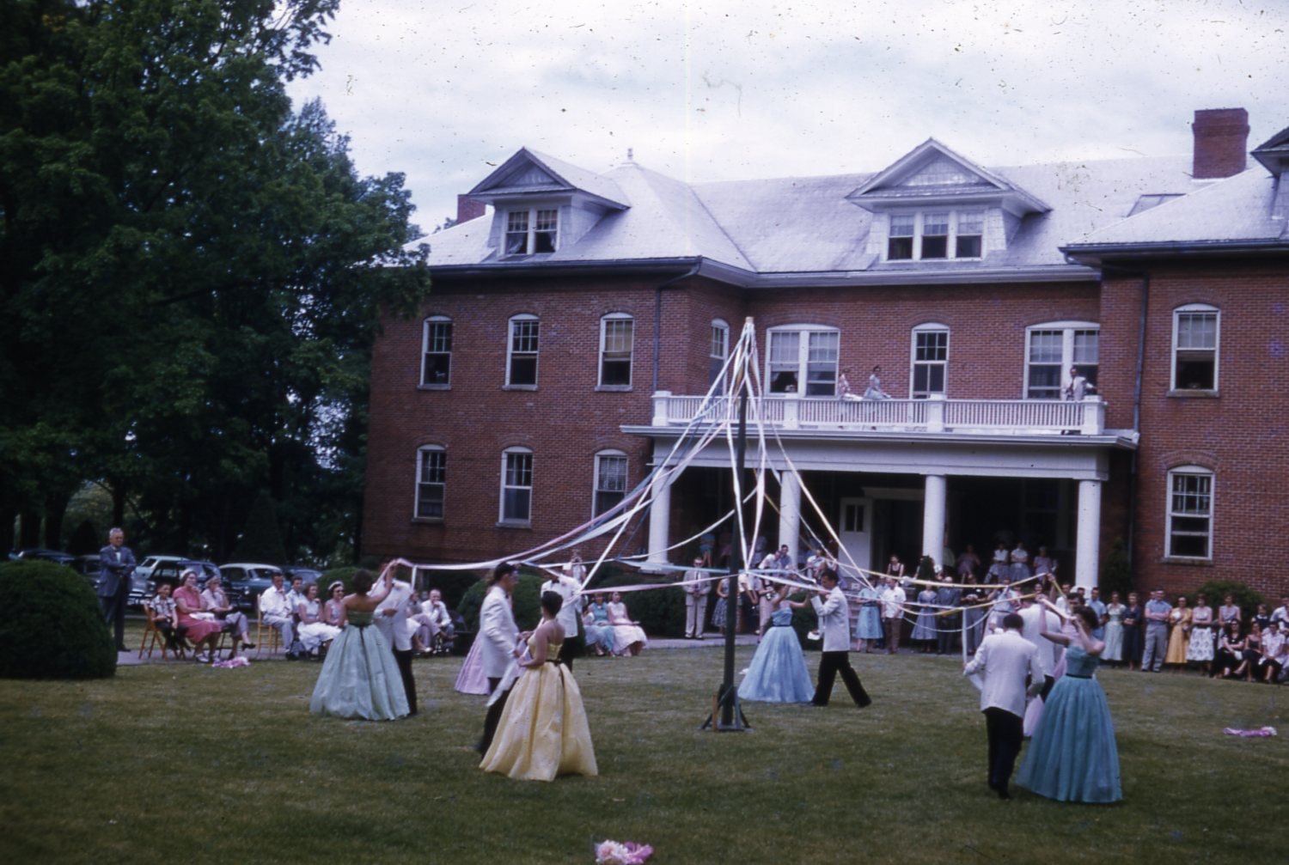
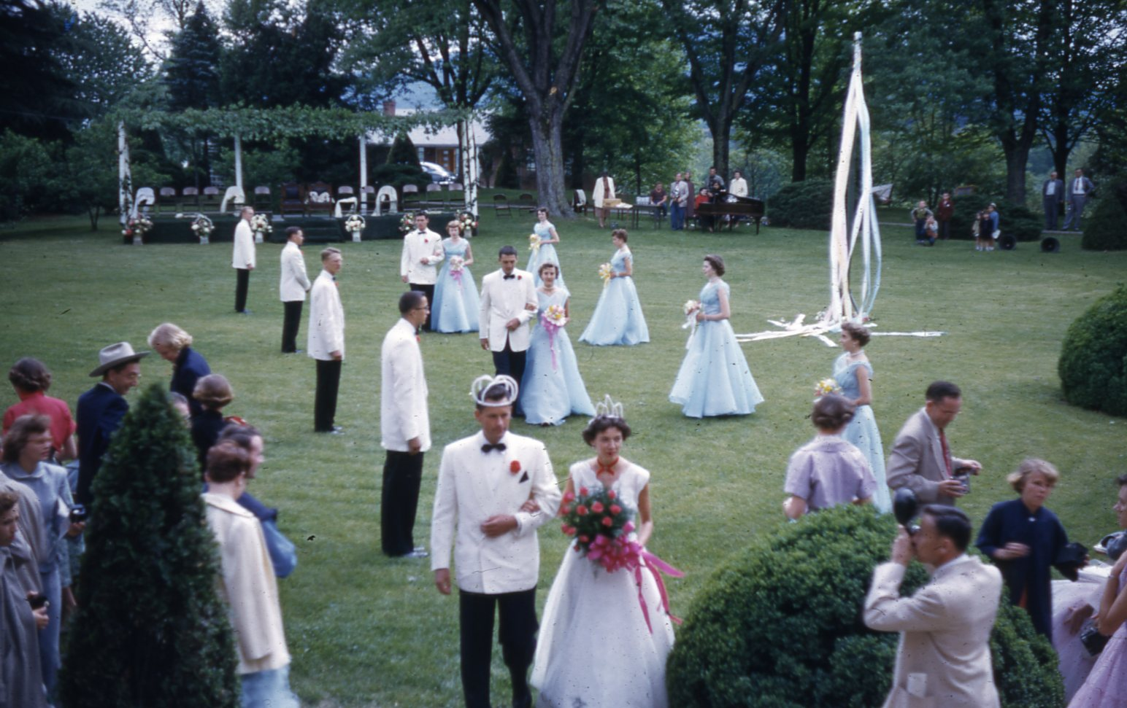
Where the Buffs Roam: Milligan’s Campus through 150 Years
May Day Festival
The Holloway Archives at Milligan College

Slide 28
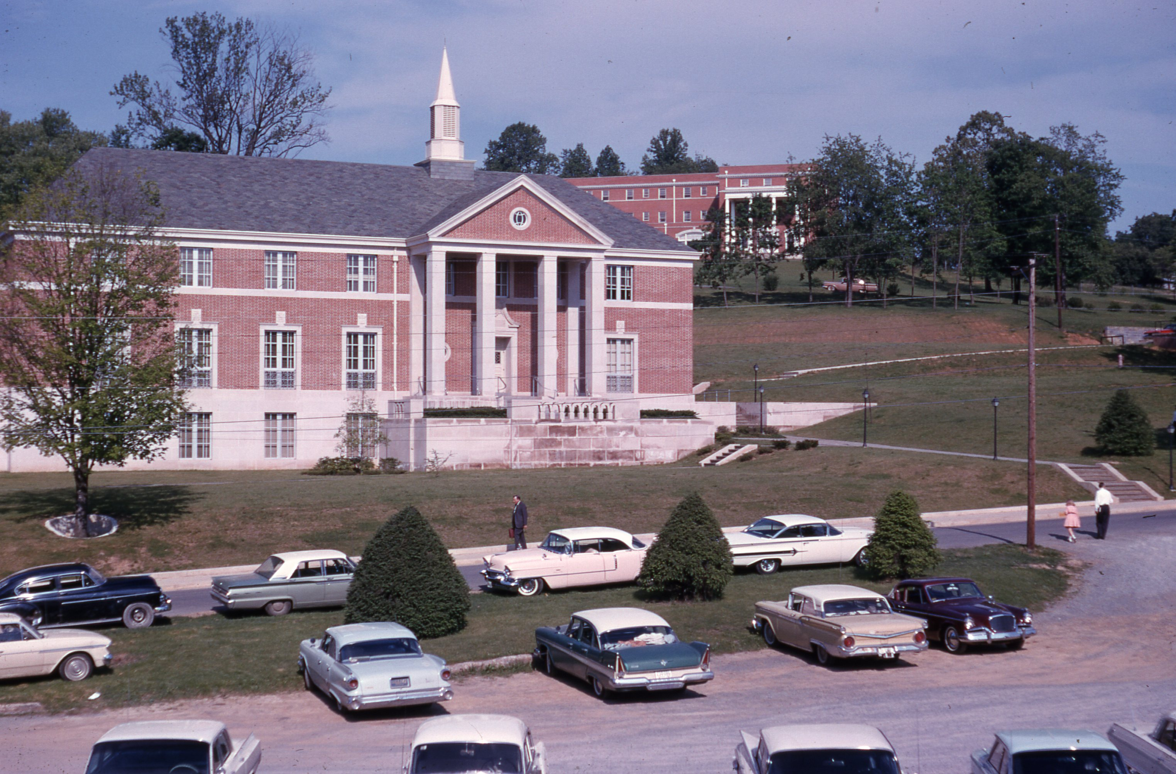
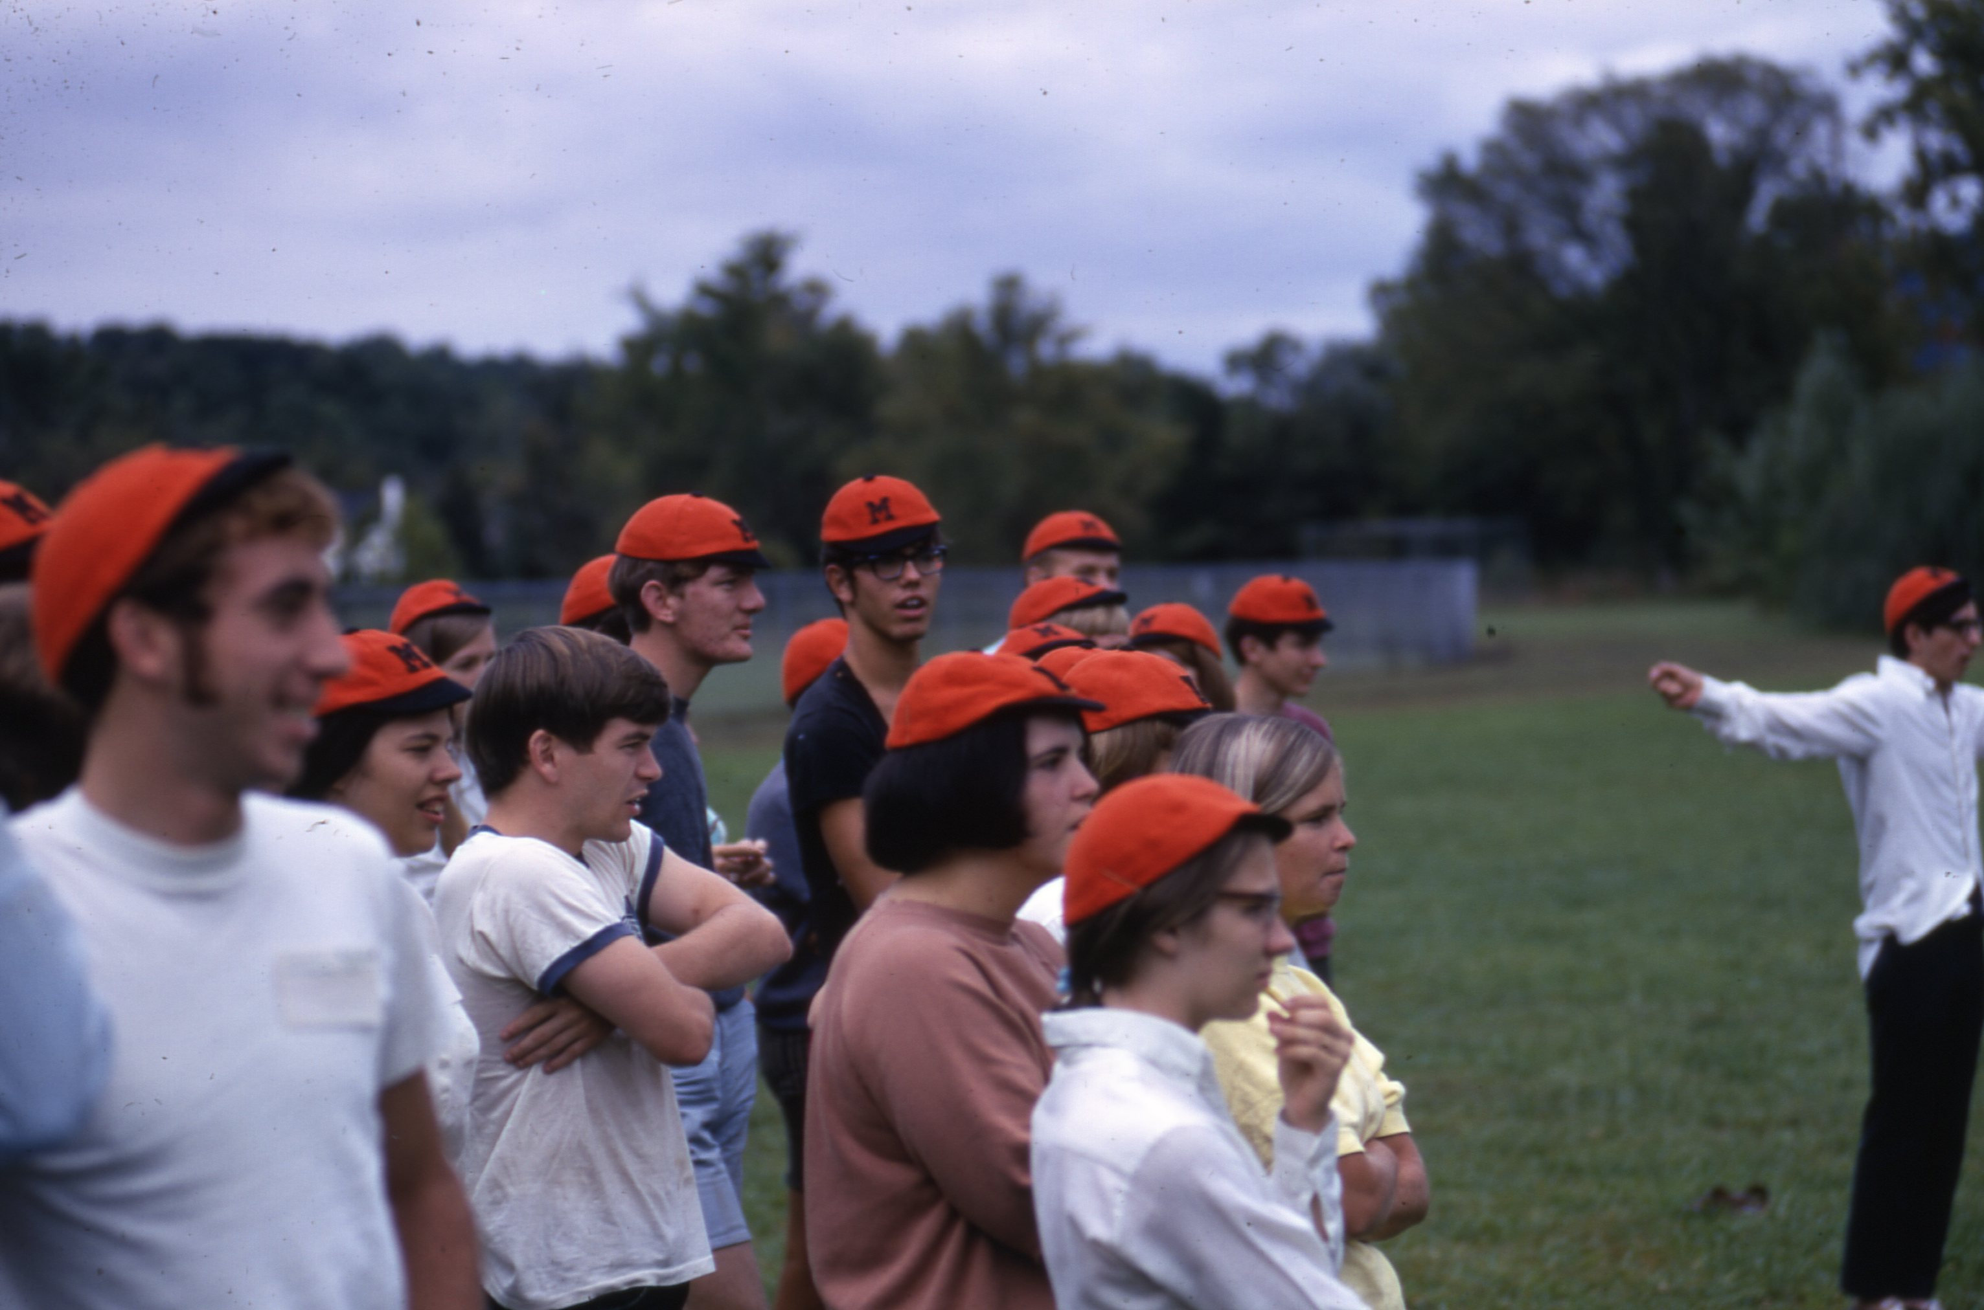
Where the Buffs Roam: Milligan’s Campus through 150 Years
Freshman Week
The Holloway Archives at Milligan College

Slide 29
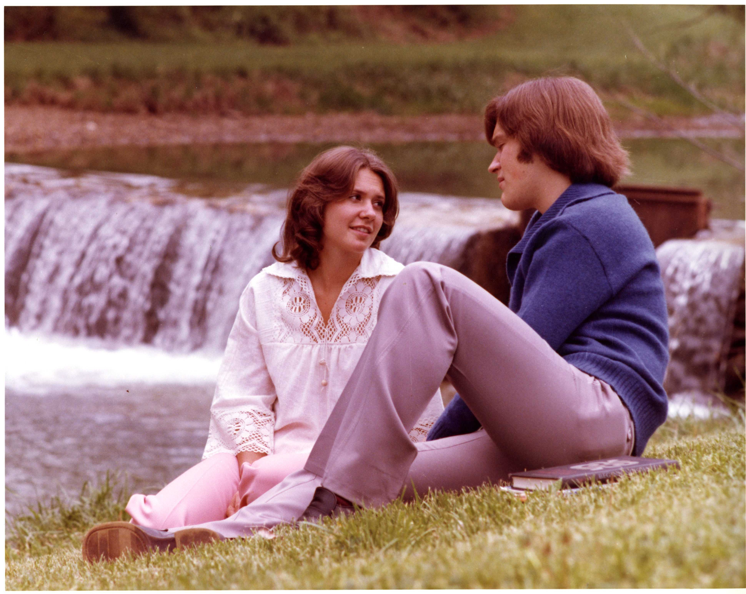
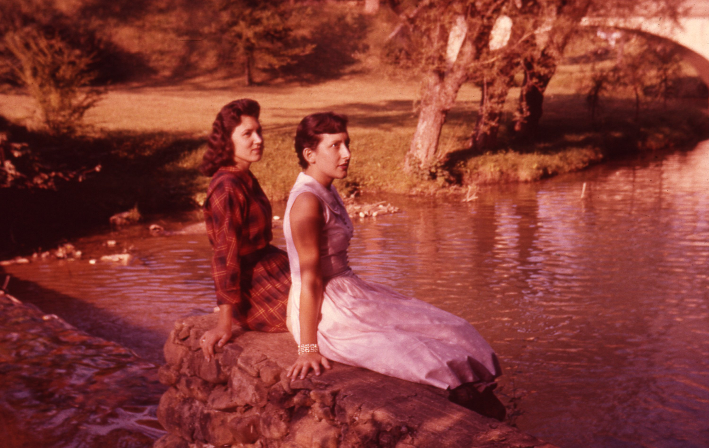
Where the Buffs Roam: Milligan’s Campus through 150 Years
Buffalo Creek
The Holloway Archives at Milligan College

Slide 30
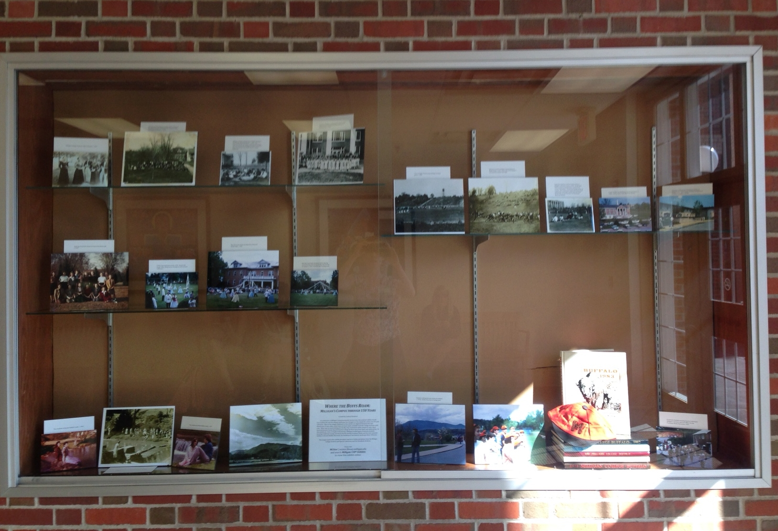

Slide 31
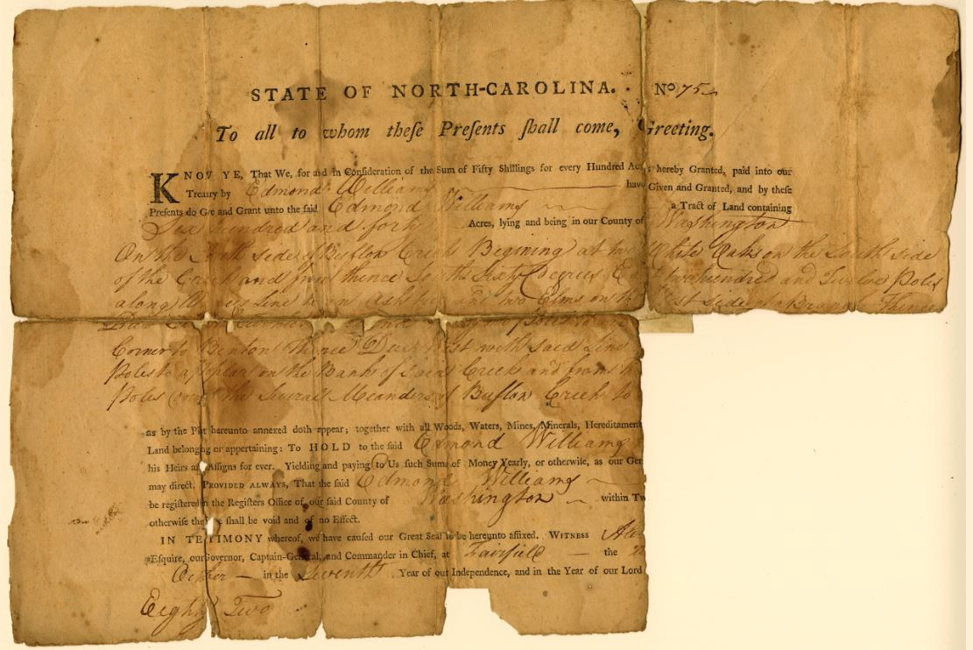
“Christian Education, the Hope of the World”: An Early History of Milligan College
The Holloway Archives at Milligan College

Slide 32
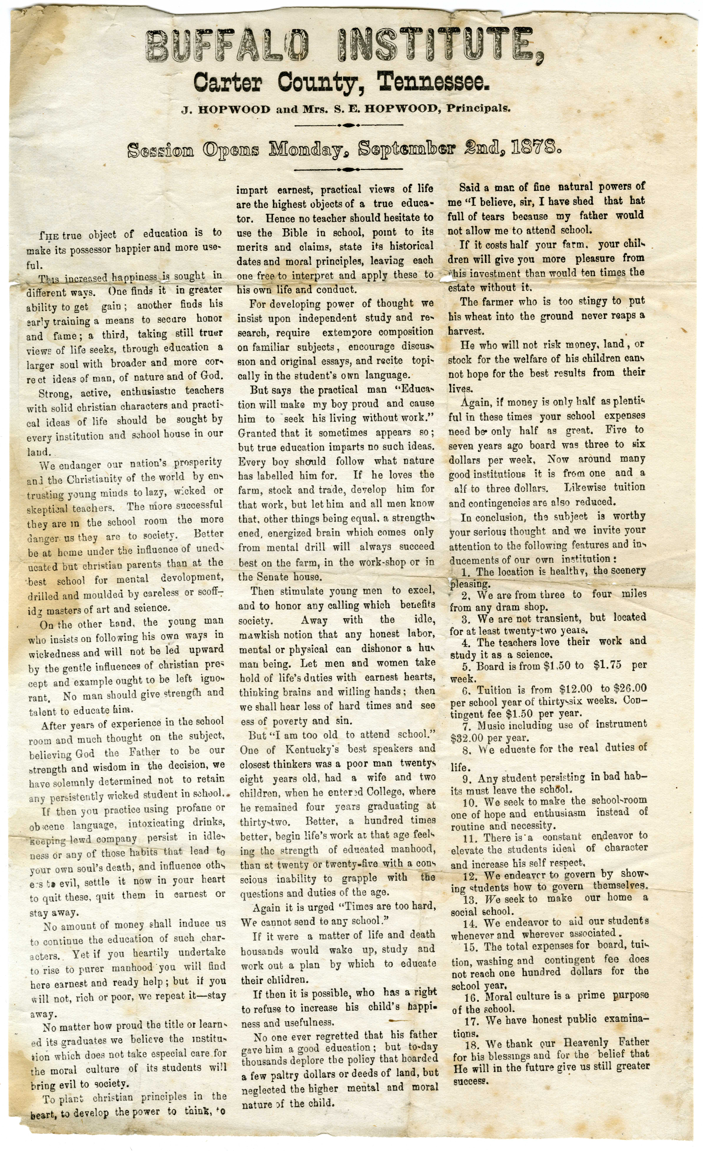
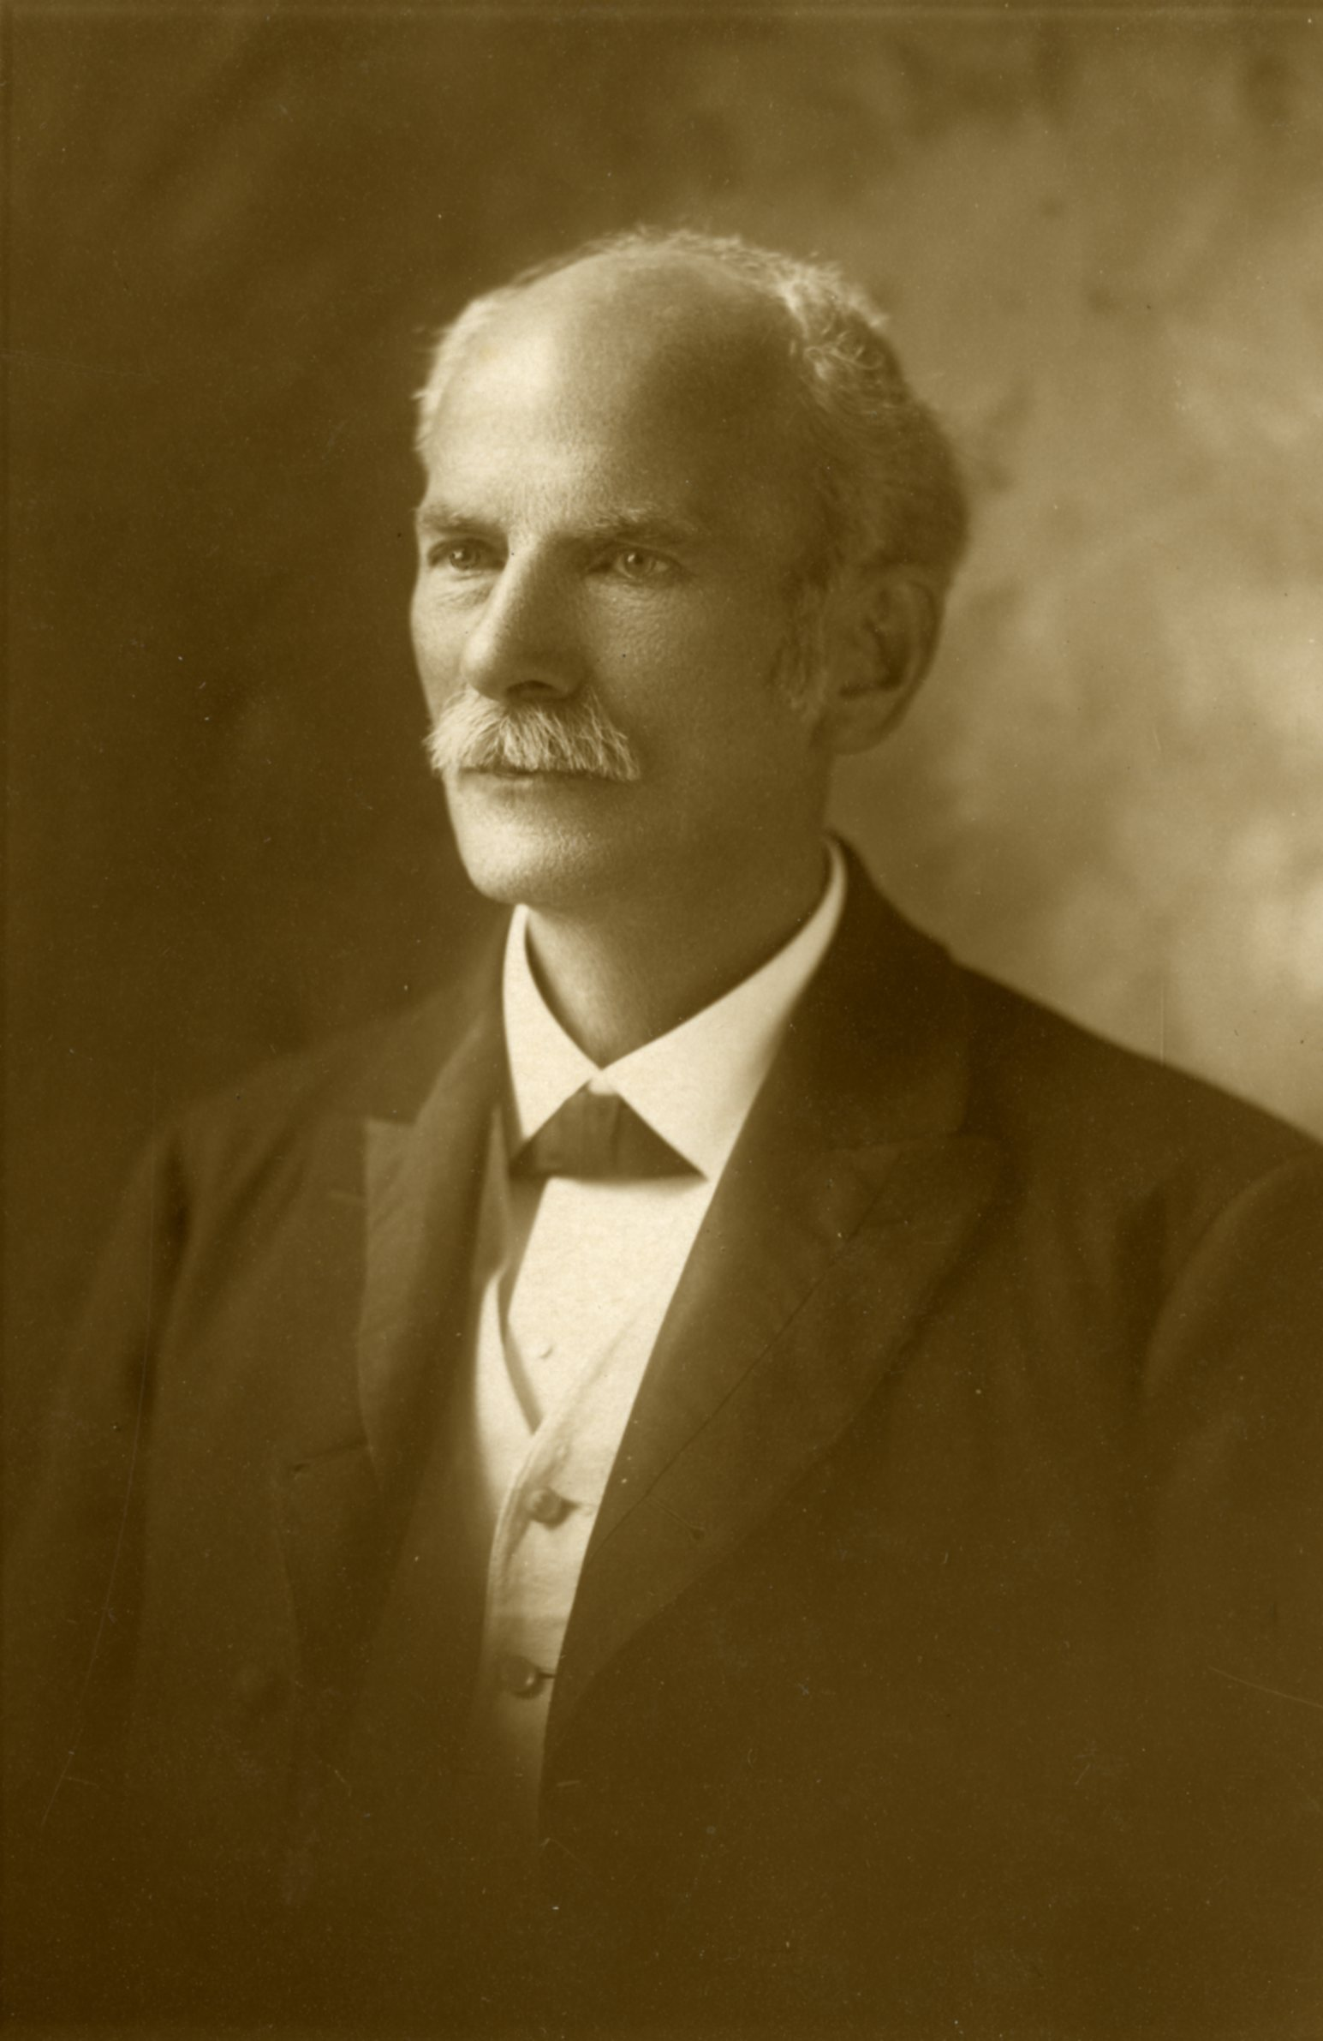
“Christian Education, the Hope of the World”: An Early History of Milligan College
The Holloway Archives at Milligan College

Slide 33
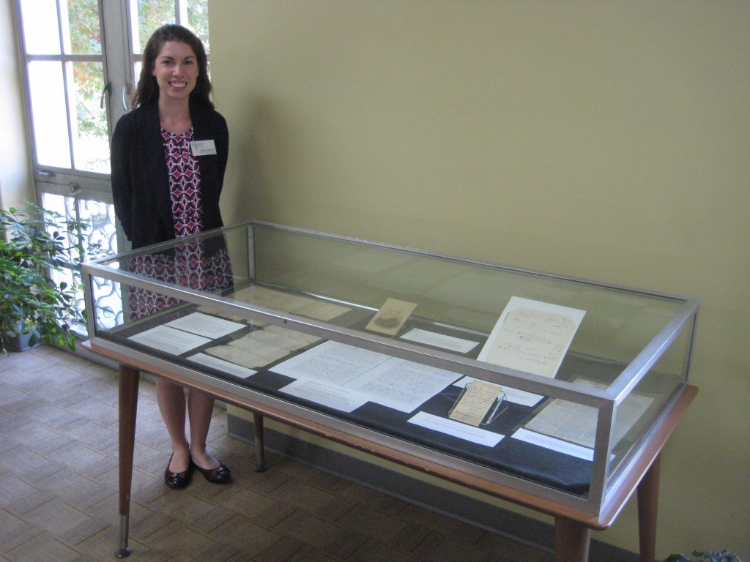
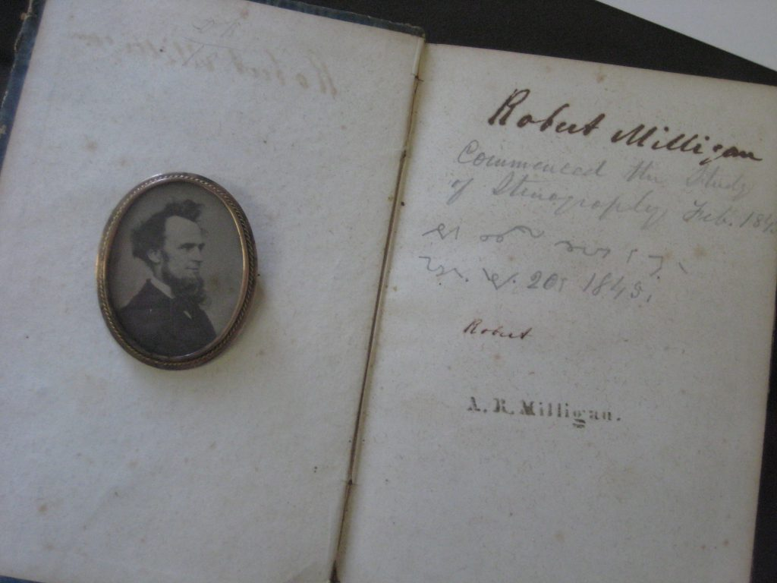
“Christian Education, the Hope of the World”: An Early History of Milligan College
Photo credit: Gary Daught

Slide 34
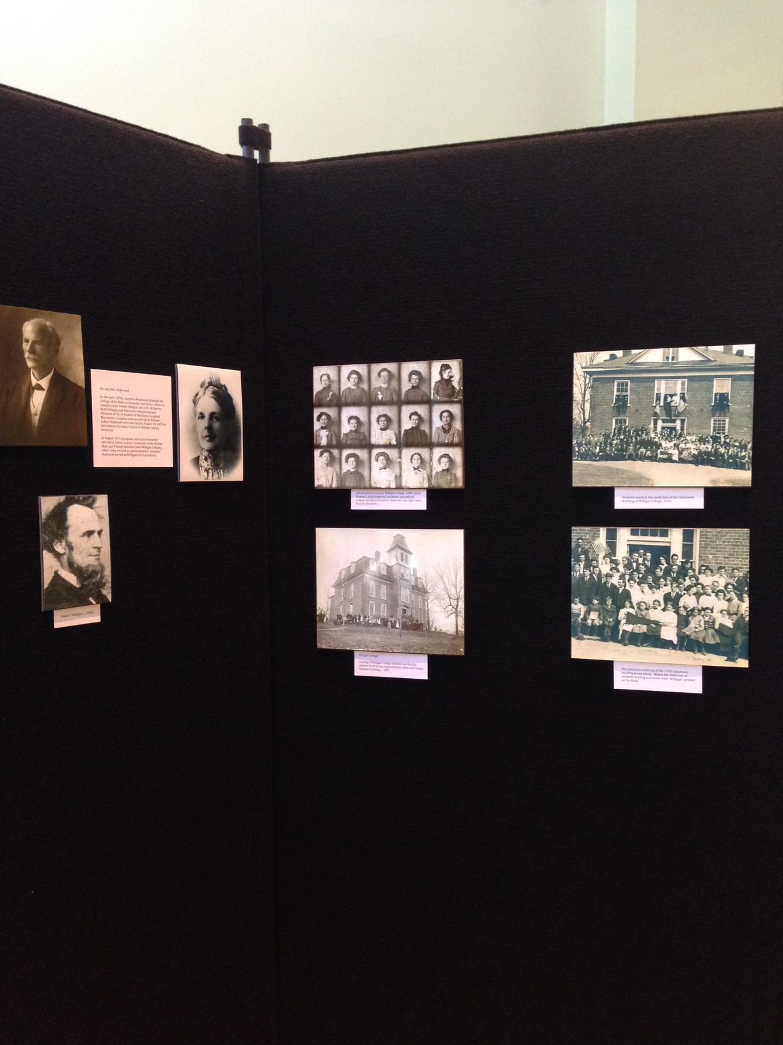
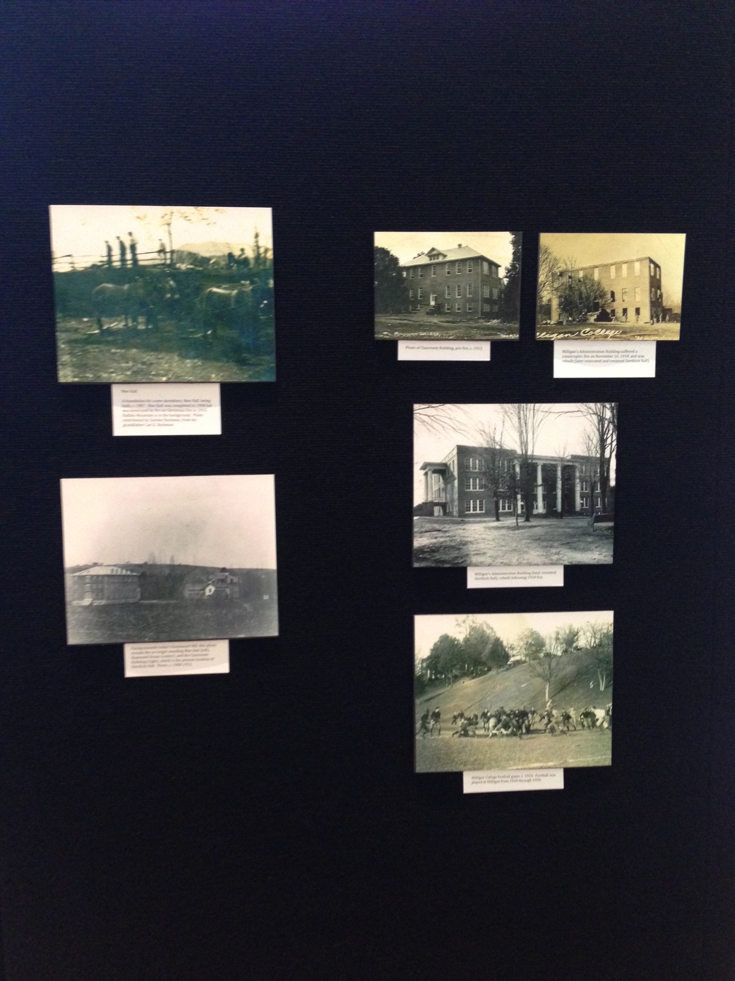
Celebrating 150 Years of Milligan History and Memory

Slide 35
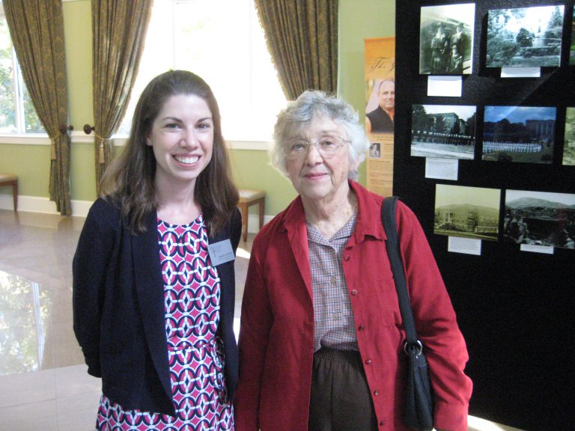
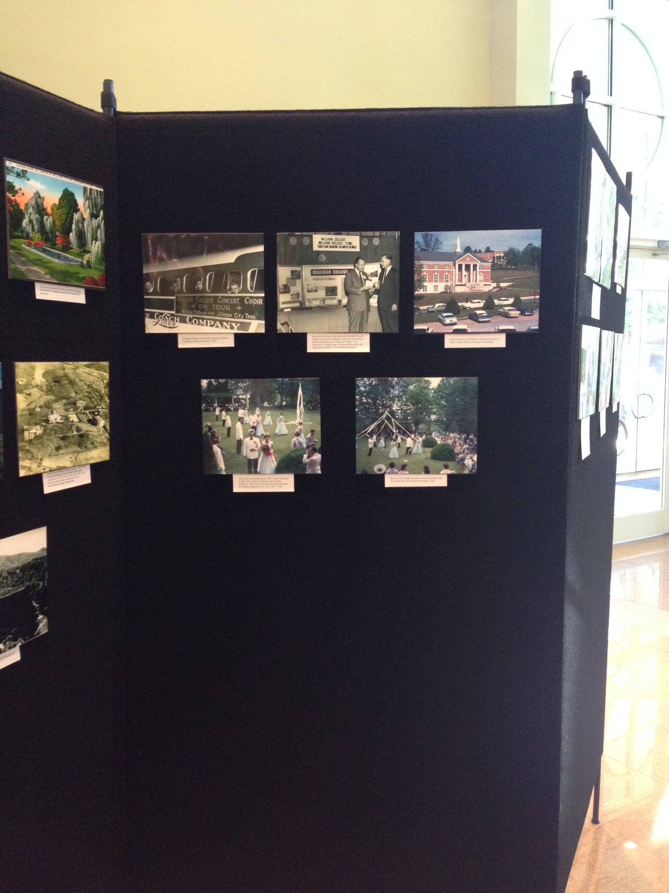
Celebrating 150 Years of Milligan History and Memory
Rosemarie Shields (right), Writer and Director of Forward with Faith: The Milligan College Story.
Photo credit: Gary Daught.

Slide 36
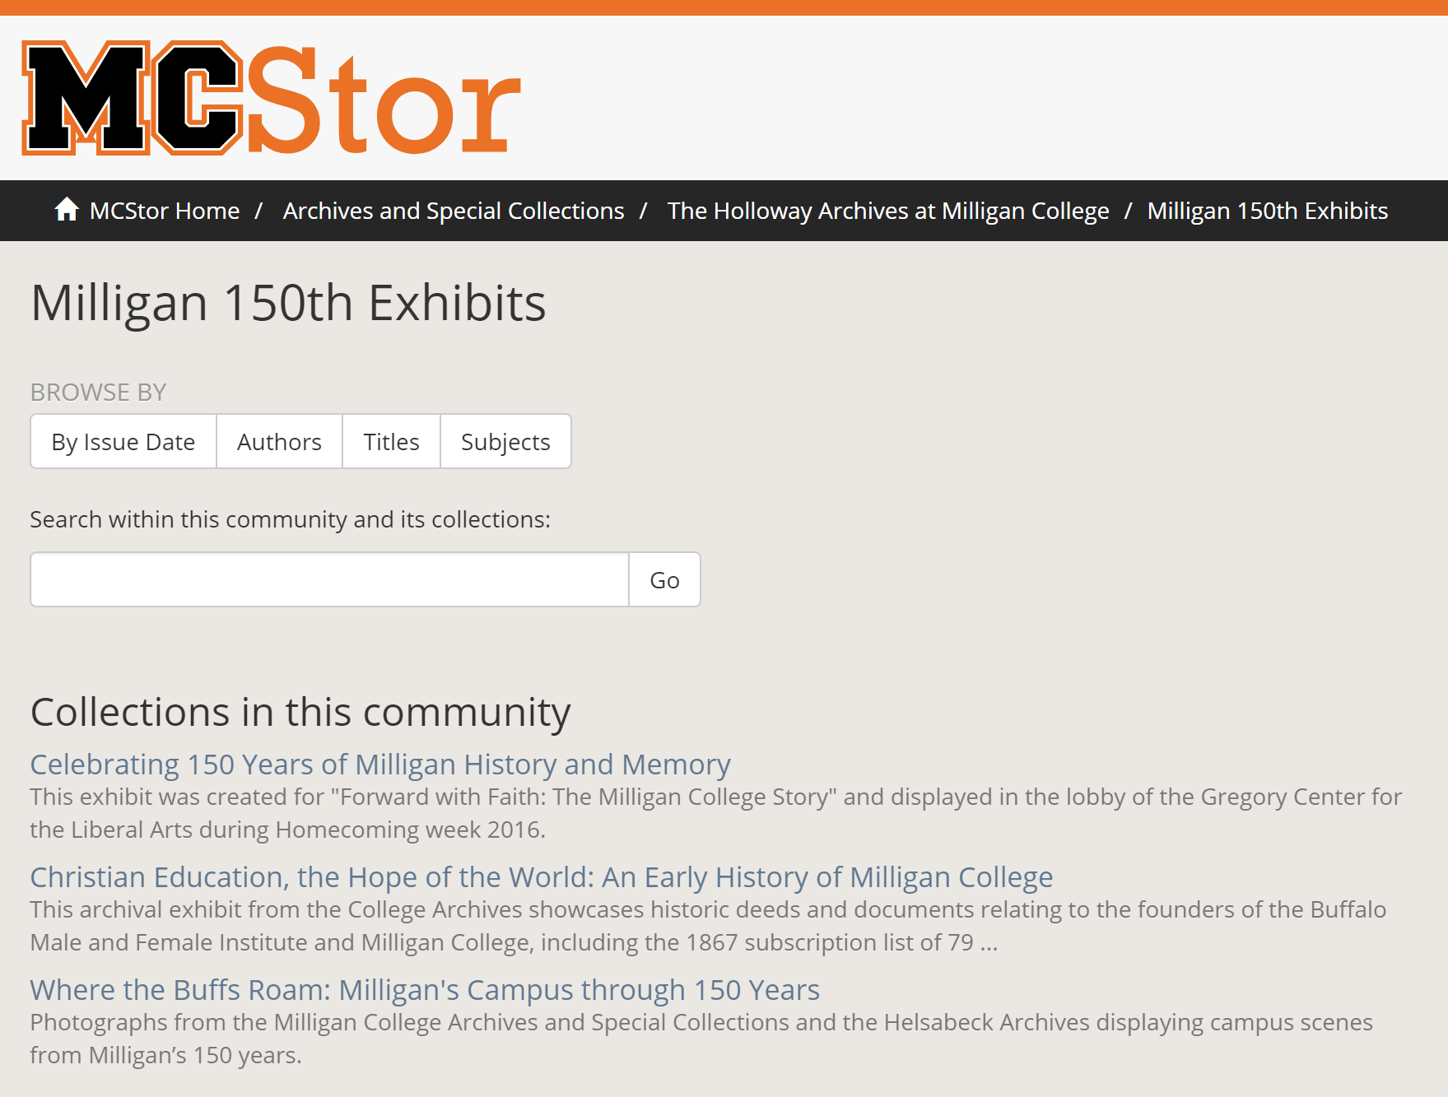
Archive Exhibits Online

Slide 37
Promoting Archives After 150th
Milligan Oral History Program
Teaching with Primary Sources
TIMH Historical Timeline
Continue building Archive access in MCStor, Milligan’s Digital Repository

Slide 38
Please contact me
lrkenderes@milligan.edu
Lindsay Kenderes
Milligan College

