Slide 1
A Study of Racism on the Campus of Milligan College
Kaylynn Blosser
Academic Advisor: Dr. Rubye Beck

Slide 2
The Beginning of a Research Idea
The Campus – Wide Conversation
The Building Frustration
Questions:
  Was there a point to these conversations for Milligan in particular?
  In what ways was racism a problem on Milligan’s campus?

Slide 3
Literature Review
Racism: A Serious Issue
Joking and Offensive Comments
Institutional Racism
The Impact of Diversity Classes

Slide 4
Research Design
Sample development: Goah vs. Non-Goah
Survey Design: Anonymous
Question Types: Multiple Choice, True or False, and Open-Ended

Slide 5
Methods
57 Goah Students
100 Non-Goah Students
10 – 20 Minute Survey
Qualtrics Survey Software
Cross – Tabulations and Statistical Assessments

Slide 6
Results: Multiple Choice and True or False Questions
Race identified as reason for being treated differently
Racist Comments and Non-Verbal Interactions
Student – Student Interactions
Student Perceptions
Physical Acts of Aggression

Slide 7
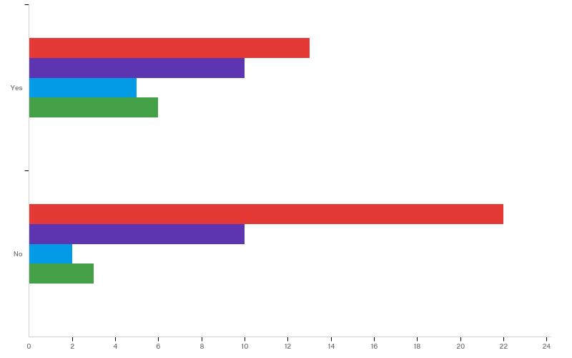
“Milligan College has a very racist atmosphere” Responses: Goah vs. Non-Goah Students
Strongly Disagree
Yes
Somewhat Disagree
Neither Agree nor Disagree
Somewhat Agree
Goah Diversity Scholar?
Strongly Disagree
No
Somewhat Disagree
Neither Agree nor Disagree
Somewhat Agree
Number of Respondents

Slide 8
Results: Multiple Choice and True or False Questions
Physical Acts of Aggression

Slide 9
Results: Open-Ended Questions
Racist Comments and Social Stigma
Understanding Diversity
Milligan’s Representation
The “Goah – Bias”

Slide 10
Discussion
Understanding Racism: Jokes and Comments
Ethnic Studies Requirements
Fostering Friendships

Slide 11
Conclusion
Student-Student Interactions
Diversity Classes
Participating in Diversity Events
Familiarization

Slide 12
Questions?

Slide 13
Sources
Chao, R. C., Mallinckrodt, B., & Wei, M. (2012). Co-occurring presenting problems in African American college clients reporting racial discrimination distress. Professional Psychology: Research And Practice, 43(3), 199-207. doi:10.1037/a0027861
Fordham, S., & Ogbu, J. U. (1986). Black student’s success: Coping with the “burden of ‘acting White.’” Urban Review, 18(3), 176-206
Goah Diversity Scholars. (n.d.). Retrieved April 11, 2016, from http://www.milligan.edu/goah/#goah
Hall, B., & Closson, R. B. (2005). When the Majority is the Minority: White Graduate Students' Social Adjustment at a Historically Black University. Journal Of College Student Development,46(1), 28-42.
Harper, S. R. (2006). Peer Support for African American Male College Achievement: Beyond Internalized Racism and the Burden of "Acting White.". Journal Of Men's Studies, 14(3), 337-358.
Harwood, S. A., Huntt, M. B., Mendenhall, R., & Lewis, J. A. (2012). Racial microaggressions in the residence halls: Experiences of students of color at a predominantly White university.Journal Of Diversity In Higher Education, 5(3), 159-173. doi:10.1037/a0028956
Kordesh, K. S., Spanierman, L. B., & Neville, H. A. (2013). White University Students' Racial Affect : Understanding the Antiracist Type. Journal Of Diversity In Higher Education, 6(1), 33-50.

Slide 14
Sources
Marcus, A., Mullins, L. C., Brackett, K. P., Tang, Z., Allen, A. M., & Pruett, D. W. (2003). PERCEPTIONS OF RACISM ON CAMPUS. College Student Journal, 37(4), 611-626.
McClelland, K., & Linnander, E. (2006). The Role of Contact and Information in Racial Attitude Change among White College Students. Sociological Inquiry, 76(1), 81-115. doi:10.1111/j.1475-682X.2006.00145.x
Merriam-Webster Online Dictionary. (n.d.). Retrieved April 27, 2016, from http://www.merriam-webster.com/dictionary/racism
Milligan Catalog, 2016-2017 [Digital image]. (n.d.). Retrieved March 1, 2017, from https://www.milligan.edu/wp-content/uploads/2014/08/catalog.pdf
Mohamed, T. (2010). Surviving the Academy: The Continuing Struggle of Minority Faculty on Mainstream Campuses. International Journal Of Diversity In Organisations, Communities & Nations, 10(4), 41-52.
Rise Above – Undergraduate Research. (n.d.). Retrieved April 25, 2016, from http://www.milligan.edu/research/#mentored-research
Poteat, V. p., & Spanierman, L. B. (2012). Modern Racism Attitudes Among White Students: The Role of Dominance and Authoritarianism and the Mediating Effects of Racial Color Blindness.Journal Of Social Psychology, 152(6), 758-774. doi:10.1080/00224545.2012.700966
Smith, J. M., Senter, M., & Strachan, J. C. (2013). Gender and White College Students' Racial Attitudes. Sociological Inquiry, 83(4), 570-590. doi:10.1111/soin.12014
Sydell, E. J., & Nelson, E. S. (2000). Modern Racism on Campus: A Survey of Attitudes and Perceptions. Social Science Journal, 37(4), 627.
Williams, D. R. (2012). Measuring Discrimination Resource. 2-4. Retrieved from http://scholar.harvard.edu/files/davidrwilliams/files/measuring_discrimination_resourc _eb_2012_0_0.pdf?m=1360043690

